Slide 1


INSPIRATION DETERMINATION EXPECTATIONS ACTIONS STRATEGIES
STRATEGIES
A PATH FOR STUDENTS’ SUCCESS
Notes:
This session can be conducted at any point after the Introductory Session, in other words when the facilitator deems it appropriate. This session is all about study strategies and skills that are essential for students’ academic success. It can be given before other sequential sessions, and then revisited at the end to brush up and self evaluate strategies and plans.
Ask students if they know what this picture is about. (Background: The picture is about chess. Chess is a two-player strategy board game played on a chessboard, a checkered game board with 64 squares arranged in an 8×8 grid. The objective of the modern chess game is to force the opponent's most important piece, the king, into checkmate. Checkmate is a position in which the king cannot be moved to avoid capture. The player with the white pieces begins the game by moving a piece to another square following the rules that govern piece movement. The players alternate moves until one player is either checkmated, resigns, or there is a draw. Thousands of books have been published relating to the strategies during the three key stages of chess, including the opening, the middle game, and the end game. (http://www.encyclopedia.com/sports-and-everyday-life/games/games-and-hobbies/chess)

Slide 2
STRATEGIES FOR STUDY SUCCESS
"To succeed, you must study the endgame
before everything else.”
Chess Grandmaster José Raúl Capablanca
STRATEGIES YOU NEED TO KNOW FOR
ACADEMIC SUCCESS
Notes:
Ask students if they know what this quote is about.
Confirm with students that academic success is the endgame and that they need to have their eyes on success while using skills and strategies to accomplish it.

Slide 3

STRATEGIES FOR ACADEMIC SUCCESS
Find the Zebra
Among the Stripes
What strategies are needed
for a successful academic endgame?
Decide what is important first.
Notes:
Have students analyze this picture of Zebras. What do they see first? How do they distinguish between the animals? (find the eyes and nose/mouth). Ask how individuals can relate to this picture. Ask if they have to overcome challenges to find things in life. Make reference to how individuals determine the most important and relevant things in life that need to be prioritize. Analyze with students what is important for being academically successful.
Ask:
What do you need to do to find your zebra/success strategies, amidst all of the different strips/distractions to your main object/goal?
What kind of strategies do you need to use to have a successful academic endgame? – take volunteer examples.
Have you done everything you need to do to be successful in school?

Slide 4

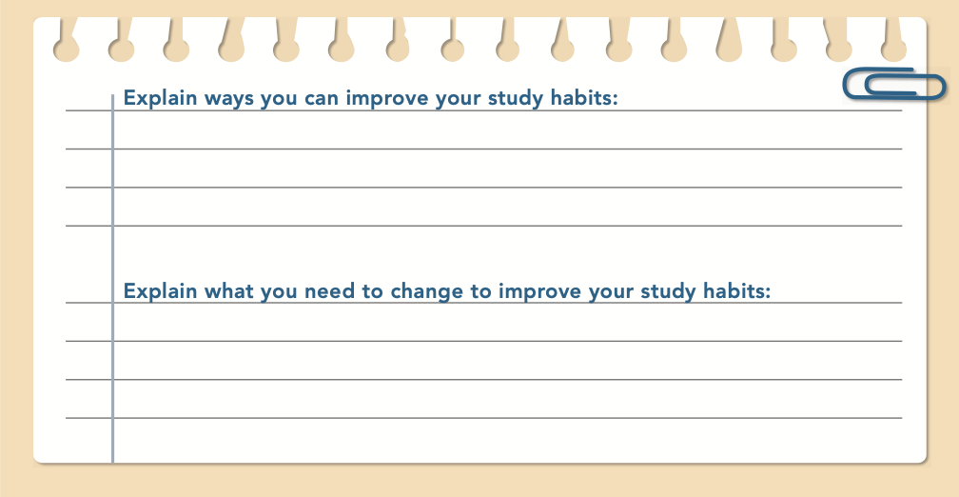
STRATEGIES FOR ACADEMIC SUCCESS – PAGE 47
What can you do to reach
your goals? What are
effective study techniques?
Notes:
Complete page 47 in the student book.

Slide 5
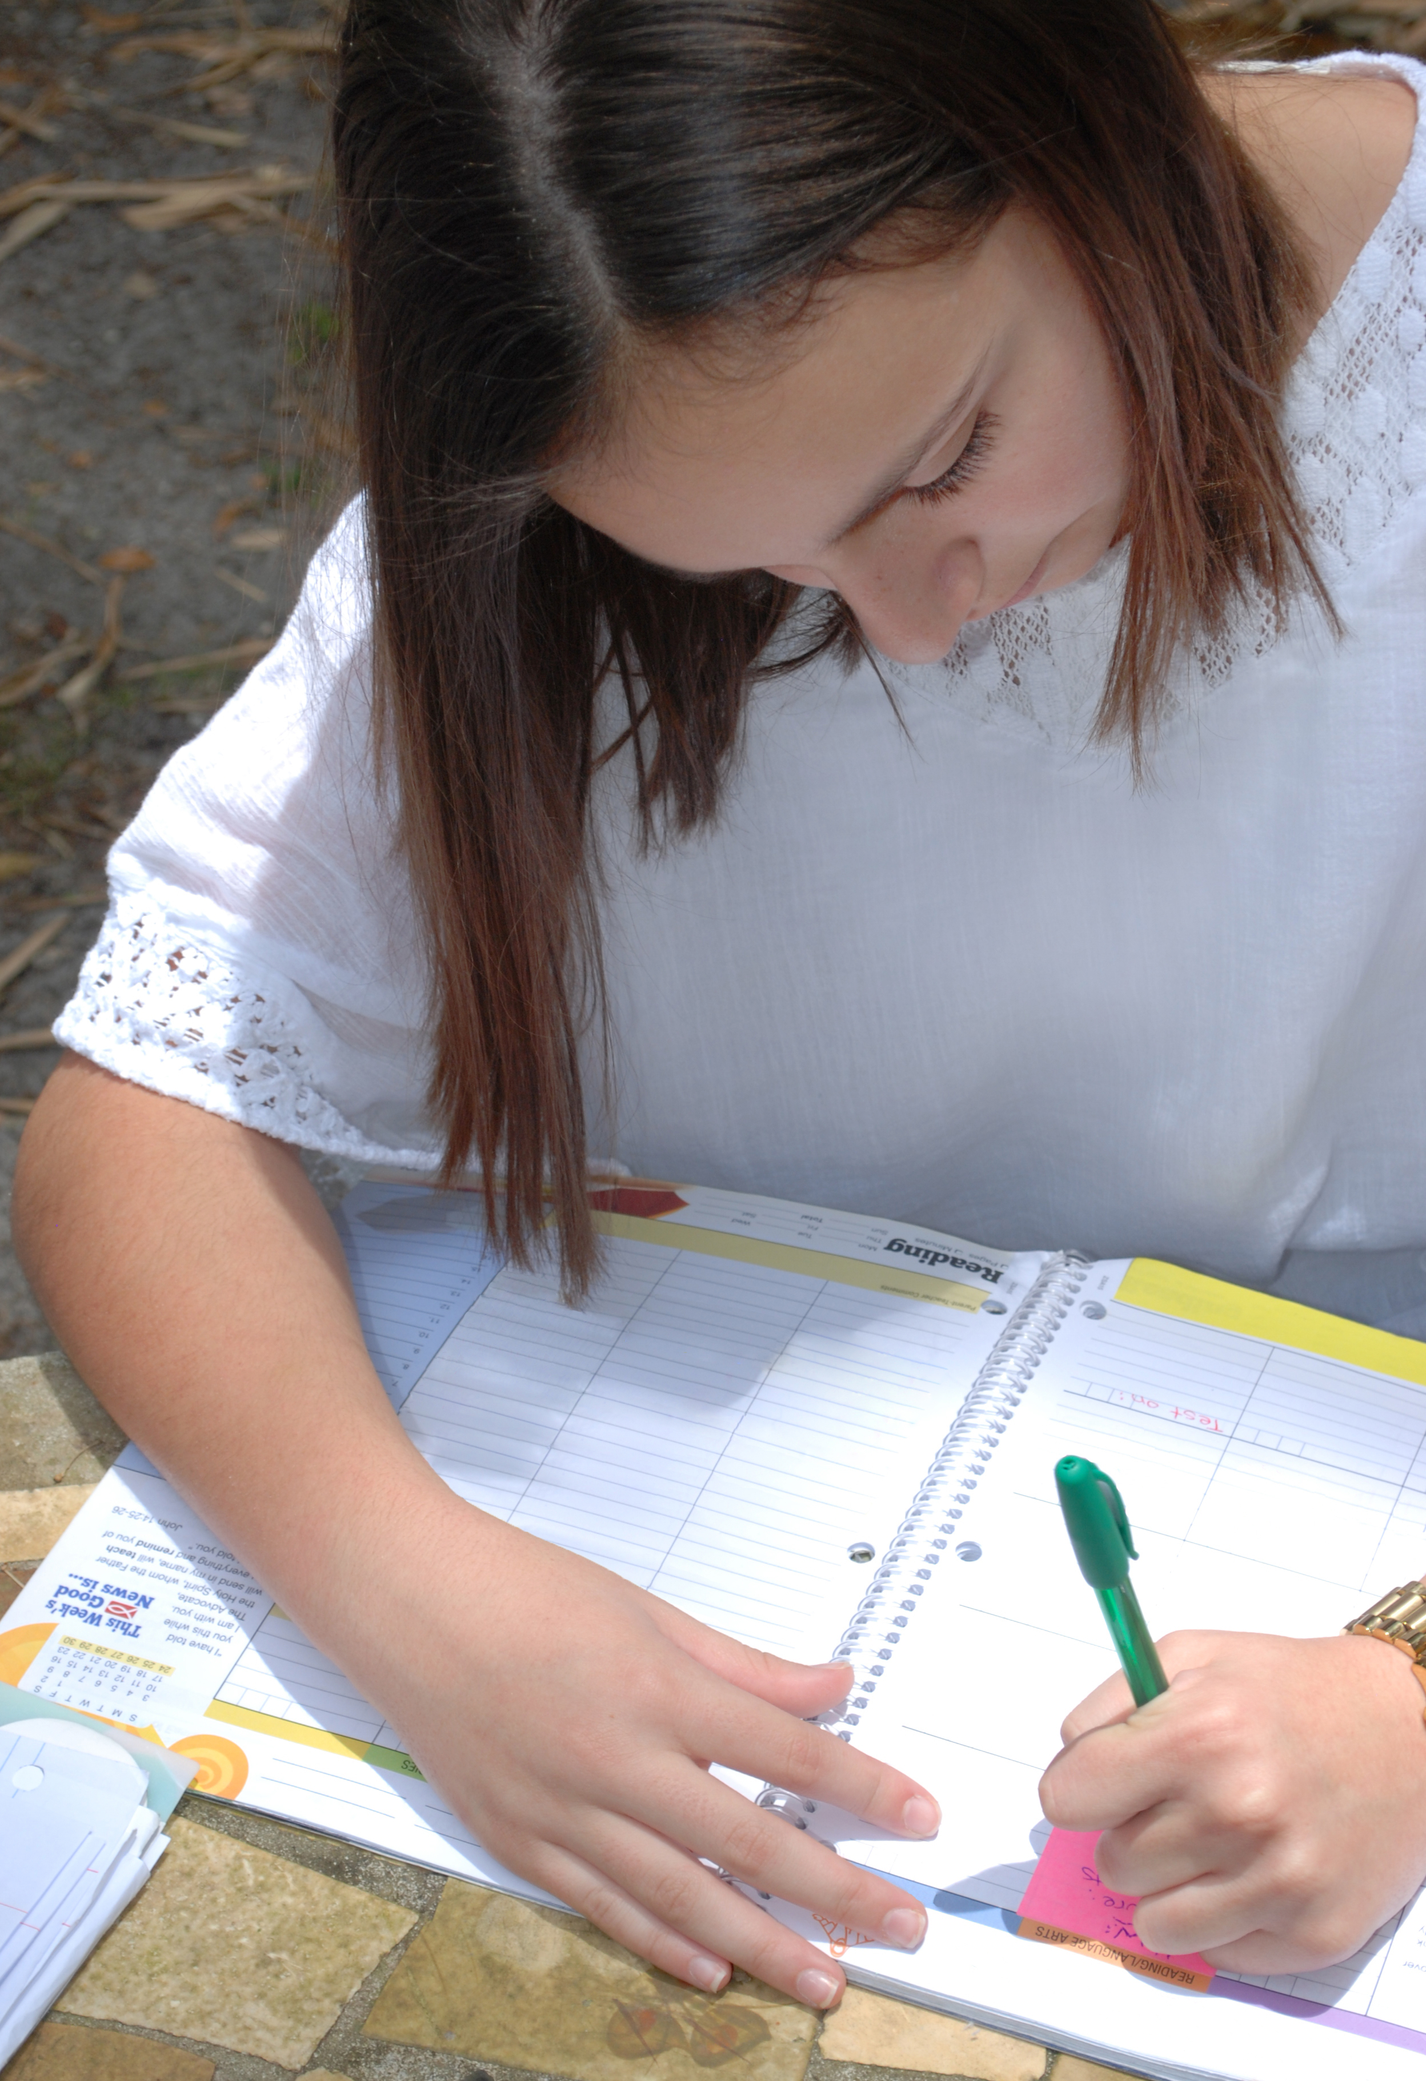

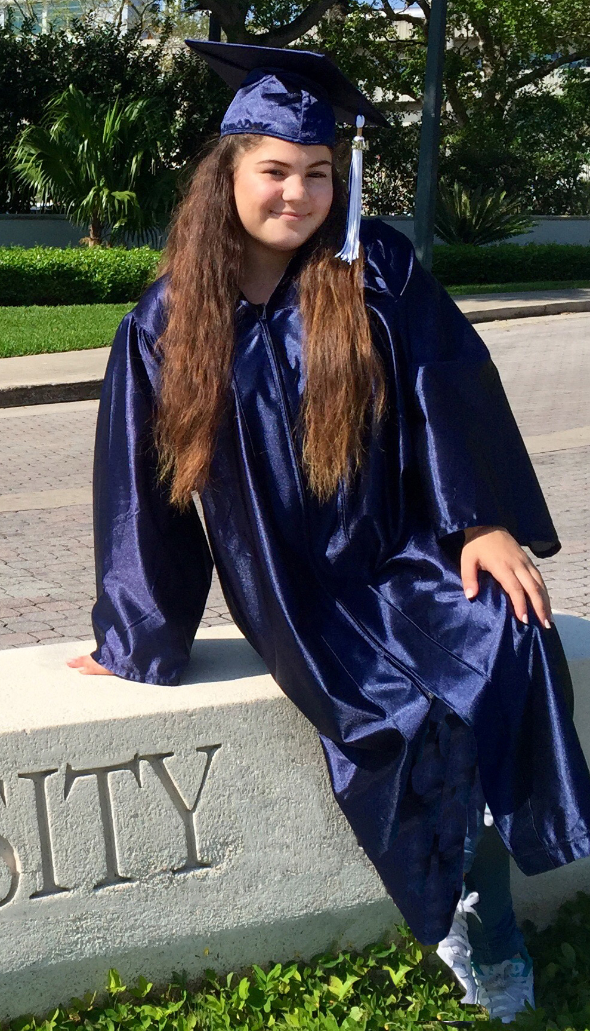
STRATEGIES FOR ACADEMIC SUCCESS – PAGES 48 - 53
STRATEGY
FOR
SUCCESS
BEST
HABITS
CHALLENGES
Notes:
Review pages 50-53 with students. The activities on pages 48 and 49 are for students to think about the tools that help them reach their academic goals.
Have students review each section and reflect on the challenges they have to face and what they can do to improve their study habits.
This is the longest part of the activity and can take 30 minutes or more depending on the students.
For students who need extra supports, show the ebook on the screen and go over it with them. They may also work in pairs or very small groups to complete (EL students especially).
Additional English language support is found in the facilitator guide.

Slide 6


STRATEGIES FOR ACADEMIC SUCCESS – PAGES 48 - 53
STUDY TIME
Notes:
Review the best habits, challenges, and strategies regarding study time on the student book page 50.

Slide 7

STRATEGIES FOR ACADEMIC SUCCESS – PAGES 48 - 53
MANAGING INFORMATION
CLARIFYING QUESTIONS
& STUDY TACTICS
Notes:
Review the best habits, challenges, and strategies regarding managing information, clarifying questions, and study tactics in the student book page 50-52.

Slide 8

STRATEGIES FOR ACADEMIC SUCCESS – PAGES 48 - 53
STUDY PLACE
& ABILITY TO FOCUS
Notes:
Review the best habits, challenges, and strategies regarding study place, and the ability to focus on the task on pages 52-52.

Slide 9

STRATEGIES FOR ACADEMIC SUCCESS – PAGES 48 - 53
Notes:
Have students go back to the original response as to what they think they can improve in their study habits. Then ask them to compare what they’ve learned about good study habits and have them add to the reflection.. With things they feel they understood to be important to them from the points presented about academic success. Have them share with a partner the best part of this study habits session that they learned.

Slide 10

NOTETAKING SKILLS – PAGES 54 - 56
What does it mean to have a bird’s eye view?
Look for clues on what stands out as important. ORGANIZE YOUR NOTES!
Notes:
Ask students if they know how to take good notes. Have them share with a partner what they think the best way to take notes in class is. Have a discussion about annotating strategies.

Slide 11
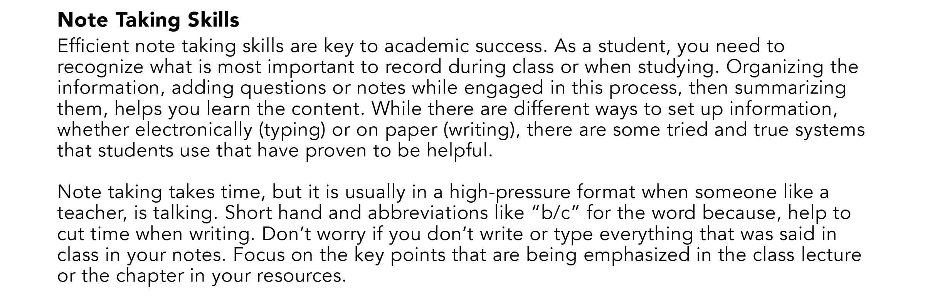
NOTETAKING SKILLS – PAGES 54 - 56
.
How do you know what to write in your notes?
How do you organize what you wrote?
.
Notes:
Review the text on student book page 54 about note taking skills.

Slide 12

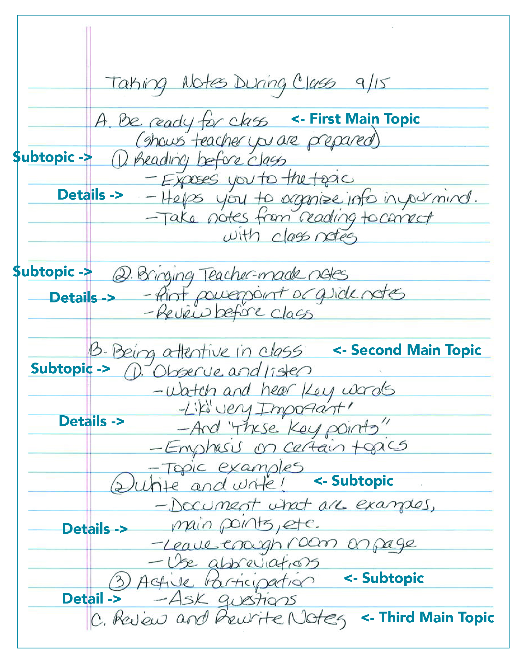
ORGANIZING YOUR NOTES
Notes:
Review with students the outline sample on page 55 of their books. Ask students to create a similar outline using a text of theirs, have them outline their notes or text chapters from one of their classes. Explain that these notes can be hand written or typed. Read page 56 of the student book with them.
See facilitator guide for an extension activity and learning abbreviations for shorthand and taking notes faster.
If time allows, extend the session to allow students to bring in notes from other classes and practice the organization of their class notes. Have them share with their peers what they’ve done. Share with them that the action to explain their notes to another is another way to digest the information they’ve organized and will serve to help them learn the material more thoroughly.

Slide 13
INSPIRATION
DETERMINATION
EXPECTATIONS
ACTION
STRATEGIES
A Path for Students’ Success
Notes:
By the end of this presentation, students should feel more comfortable with the idea that they have the tools to be successful academically. They should go back to this chapter and review strategies, and seek help from their school counselors or other adults in their lives if they need additional support.

