Slide 1


INSPIRATION DETERMINATION EXPECTATIONS ACTIONS STRATEGIES
ACTIONS
A PATH FOR STUDENTS’ SUCCESS
Notes:
Review with students the discussions that took place over the course of the fourth session.
They included:
Understanding that there are different education options after high school class
Researching about types of colleges
Visiting colleges in person or virtually
Focusing and researching on types of colleges they’d like to apply to
Discovering college prerequisites
Analyzing their college readiness plan
Confirming high school graduation requirements
Calculating GPA
Recording middle and high school curriculum
Reviewing the College Application Process—from entrance exams to essays
Creating a resume
Learning about deadlines and recommendation letters
If necessary, support students’ understanding and review areas that need emphasis

Slide 2

ACTIONS TO PLAN YOUR SUCCESS
HOW CAN YOU REACH YOUR GOALS?
Notes:
You may ask students once again to think about what being successful means to them- academically and personally. Have them review their previously written reflections. Has anything changed from that session?

Slide 3

ACTIONS TO PLAN YOUR SUCCESS
Knocking on Open Doors VS Opening Doors
Notes:
How can you open doors?
Have students take five minutes to identify what the terms KNOCKING ON DOORS AND ALSO OPENING DOORS mean,.
Next, have them check with a partner on their opinion of their peers. Have a quick discussion of each with the next two slides.

Slide 4

ACTIONS TO PLAN YOUR SUCCESS
Knocking On Doors
If opportunity doesn't knock, build a door.
Milton Berle
Notes:
Have volunteers share what knocking on doors means-
Share with students the analogy shown in the picture of their ride going by, waiting for a “door”, or waiting for an opportunity.
Ask students to volunteer about all the activities discussed in previous sessions that helped to open up inspiration, and determination– to get ideas on how to reach their goals.

Slide 5

ACTIONS TO PLAN YOUR SUCCESS
Opening Doors
What can I do to have more doors open for me? TAKE ACTION!
Notes:
How can you open doors? Have students share what the term OPENING DOORS means:
Have them think about each of the three photos shown and answer the question about opening doors and how that can relate to their future in school and the impact of that when they finish.
Note the picture of the school door opening into a hall…leads to classes that can lead them to success, the book could signify studying, and the window, is a different way that they may have the vision to see outward. What are some paths (windows) into what they can do in the future? Looking at their action plan can help! Finishing school with the best available track record and meeting the needs for the applications will help students succeed.

Slide 6
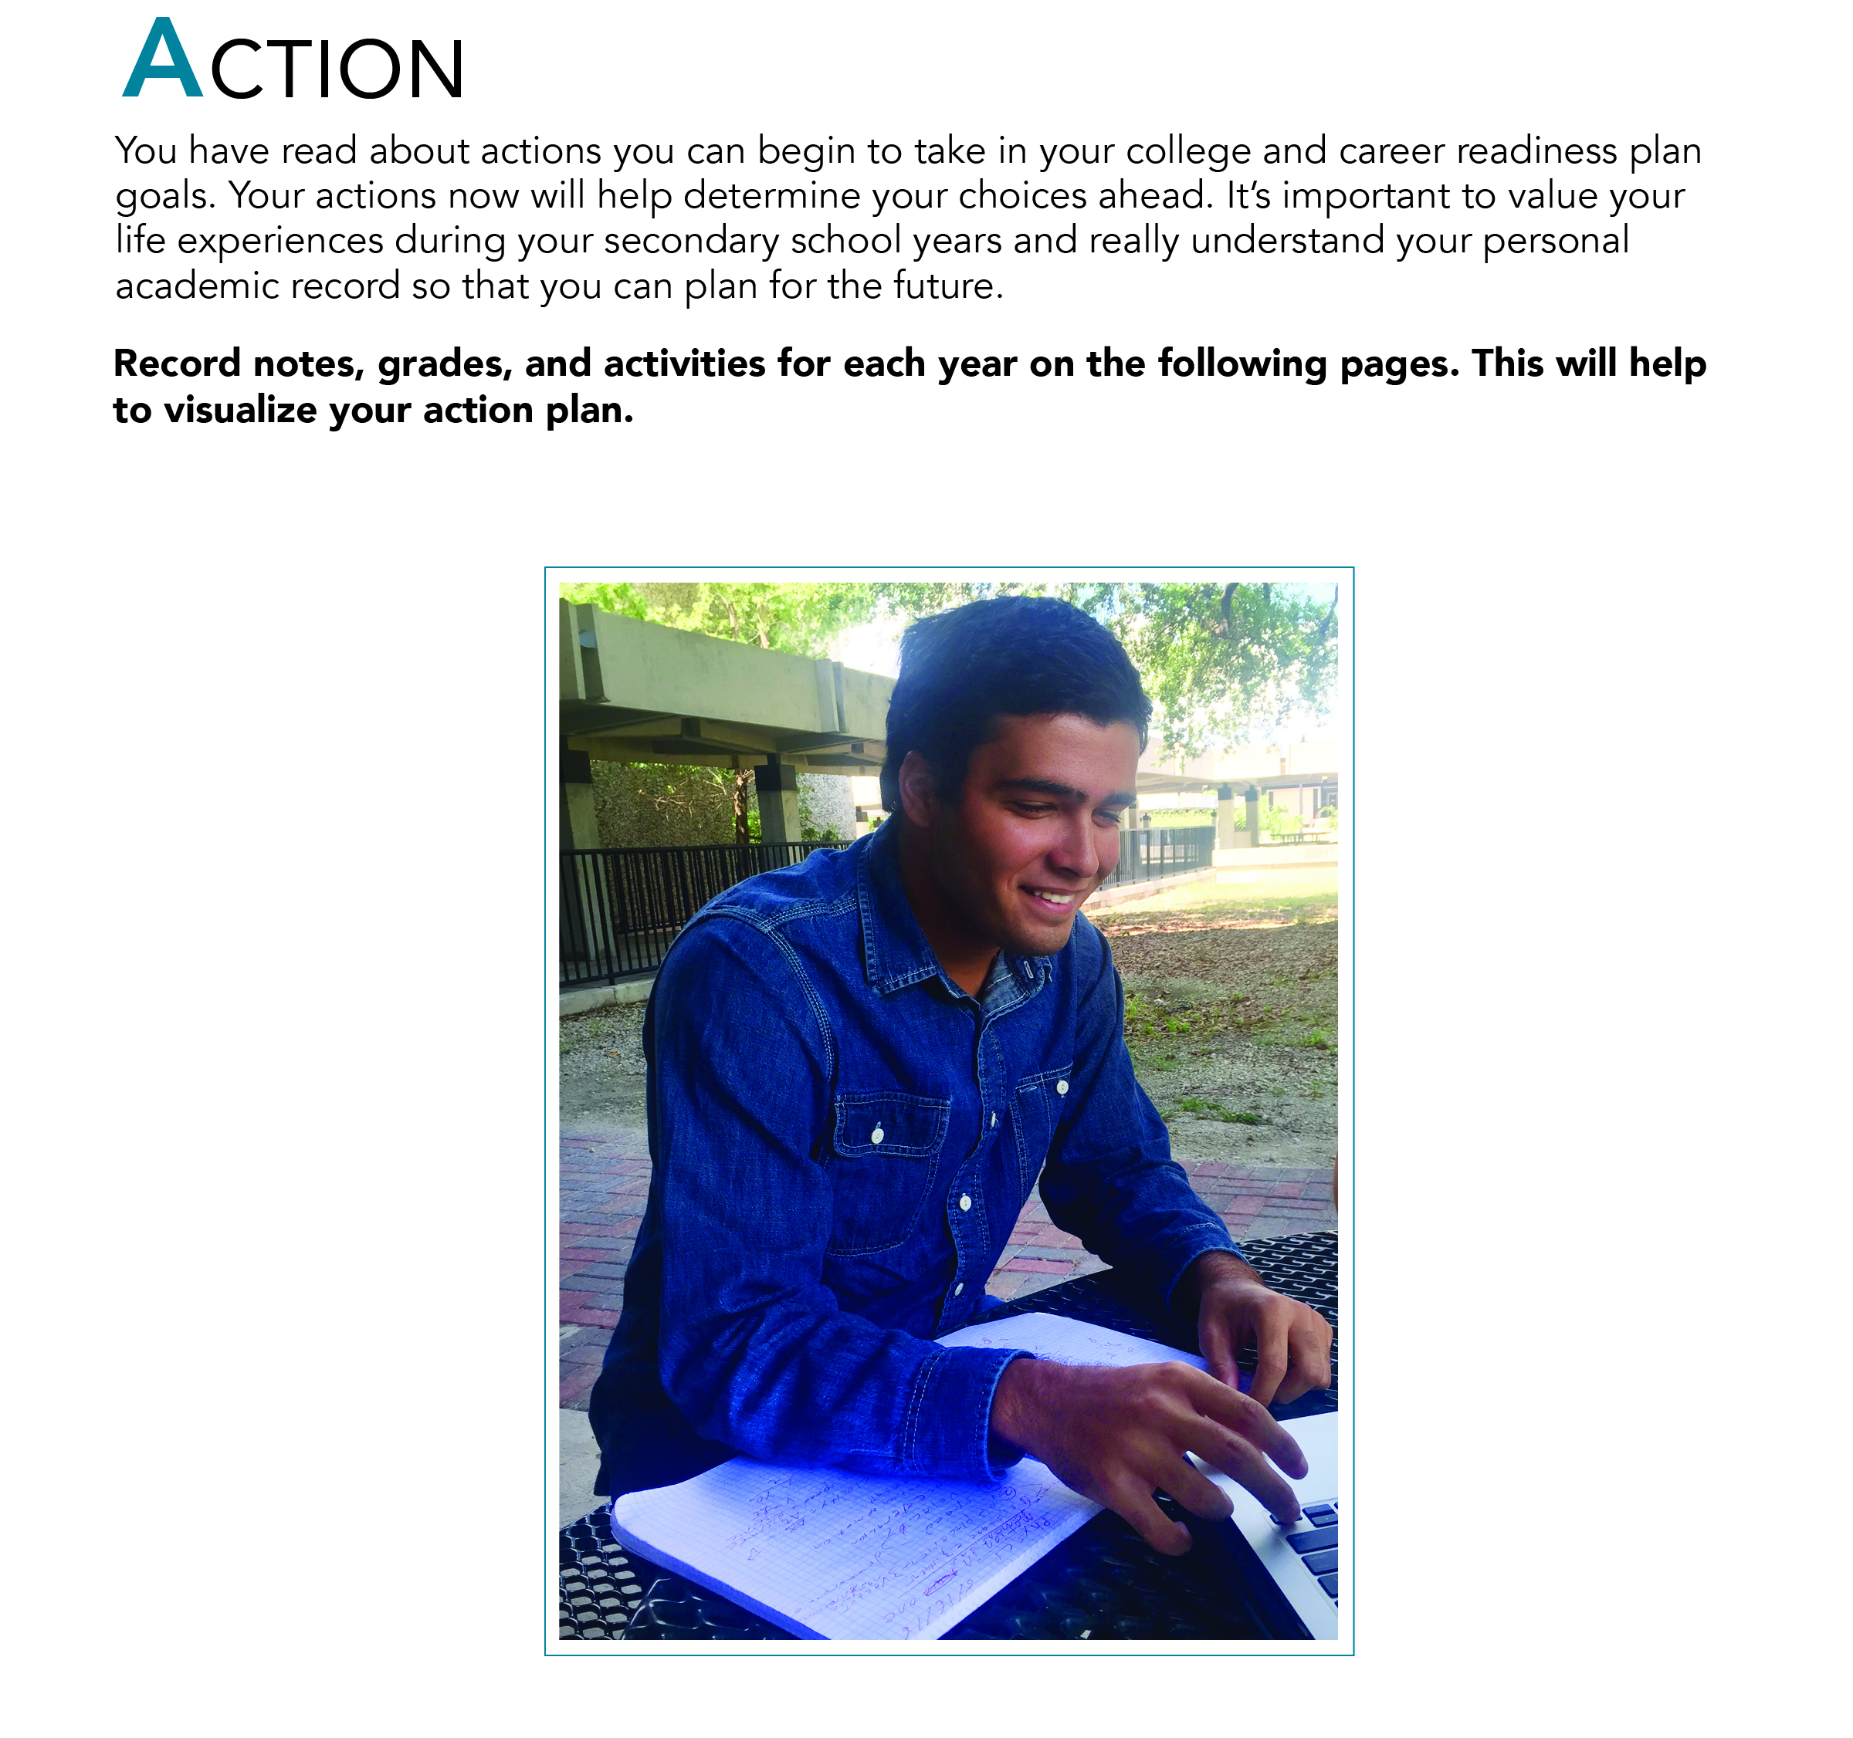
TAKE ACTION – PAGES 42 - 45
Notes:
Have them think about each of the three photos shown and answer the question about opening doors and how that can relate to their future in school and the impact of that when they finish.
Note the picture of the school door opening into a hall…leads to classes that can lead them to success, the book could signify studying, and the window, is a different way that they may have the vision to see outward. What are some paths (windows) into what they can do in the future? Looking at their action plan can help!
Have students fill in what they have done so far for each grade level. Have students refer to the bottom of each page and go through each action when applicable to their group. If it is a middle school group of students, ask them to create their own record of action plan in the note pages (student book page 62-4) so that they can refer to in their future high school experiences.
How can you open doors? Have students share what the term OPENING DOORS means:

Slide 7
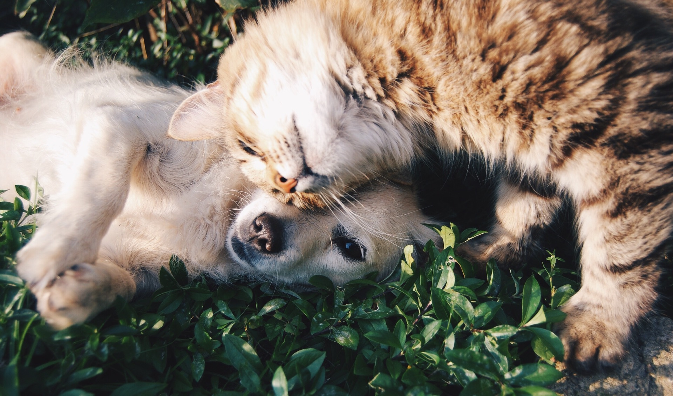
POSITIVE ACTIONS AFFECT EVERYTHING WE DO
.
What we say
What we do
How we say things
How we do things
.
.
.
“Happiness comes when your work and words are of benefit to
yourself and others.”
Buddha
Notes:
How do actions they take –words, things we do, things they say, affect those around them?
Introduce and model the idea that positive words, even constructive criticism or compliments, make a difference in how the message is received. Opening doors can be enabled in how some people relate to others– building relationships with friends as well as with mentors. Explain that they will have the chance to share with each other in this session about what they are doing in their action plans.

Slide 8

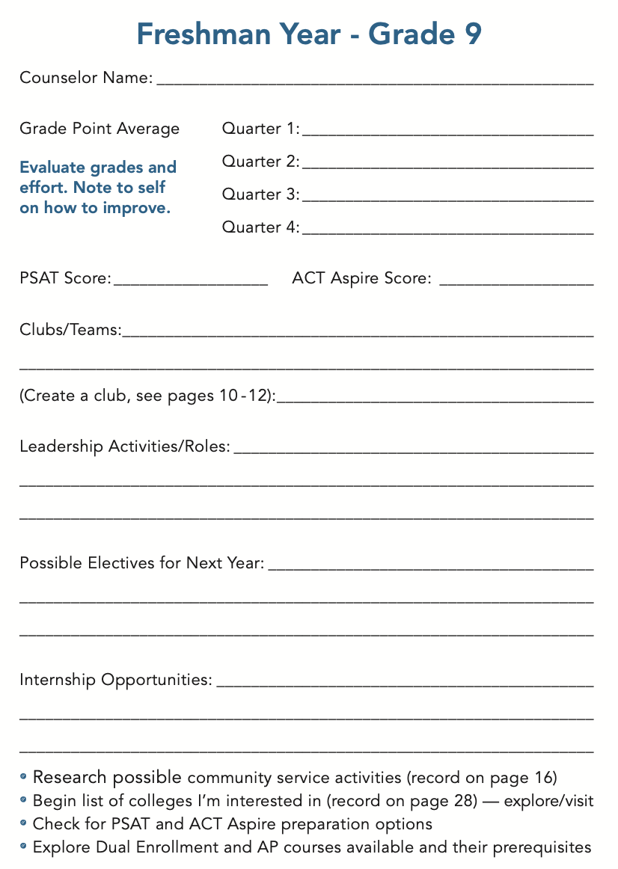
PLAN YOUR SUCCESS: FRESHMAN YEAR
SHARE EXPERIENCES:
Let’s talk about it!
Let’s discuss your progress!
Notes:
Students should use their transcripts or report cards to complete part of this page. For freshmen, review each event and review what clubs teams they are working on. Have students share in pairs or in whole group what they are doing. Allow students to share insights with each other on these.
Have volunteer students share if they’ve participated in clubs, and what they have done in those clubs. If they have had a leadership role, ask them to share what they’ve had to do. Allow students to ask questions to each other about clubs, teams, and leadership roles. Prompt students to ask questions such as if they would want to be a leader in their activities and what do they have to do to attain those positions. Ask for helpers to volunteer their ideas. Always support positive influencers and what that means in the class.
Have students research bullet points for further insight and planning.
Extensions include seeking SAT and ACT preparations free and for a fee, researching colleges on line.. Etc. See Facilitator guide for more.

Slide 9
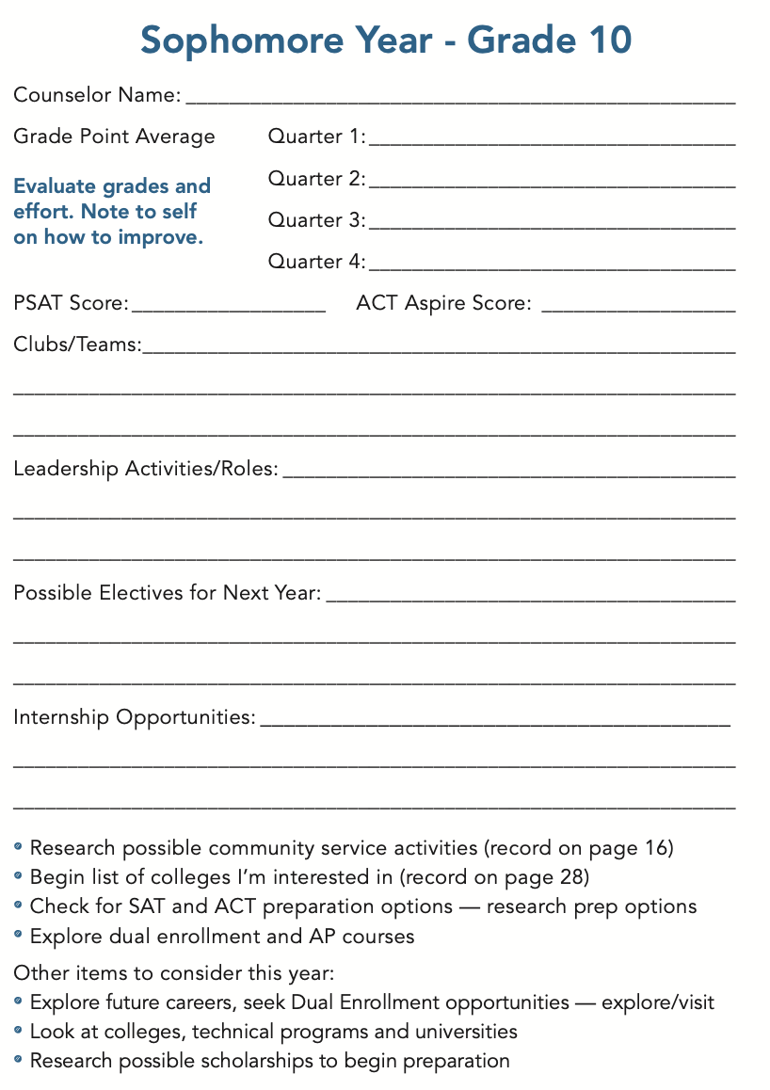
PLAN YOUR SUCCESS: SOPHOMORE YEAR
SHARE EXPERIENCES:
Let’s talk about it!
Let’s discuss your progress!
Notes:
Students should use their transcripts or report cards to complete part of this page. For sophomores, go through each event and review what clubs or teams they are working on. Have students share in pairs or in groups what they are doing. Allow students to share insights with each other on these.
Have volunteer students share if they’ve participated in clubs, and what they have done in those clubs. If they have had a leadership role, ask them to share what they’ve had to do. Allow students to ask questions of each other about clubs, teams, and leadership roles. Prompt students to ask questions such as if they would want to be a leader in their activities and what do they have to do to attain those positions. Ask for helpers to volunteer their ideas. Always support positive influencers and what that means in the class.
Have students research bullet points for further insight and planning.
Check out extension activity in Facilitator Guide about financial options in college: How to Pay for College- research and report.

Slide 10
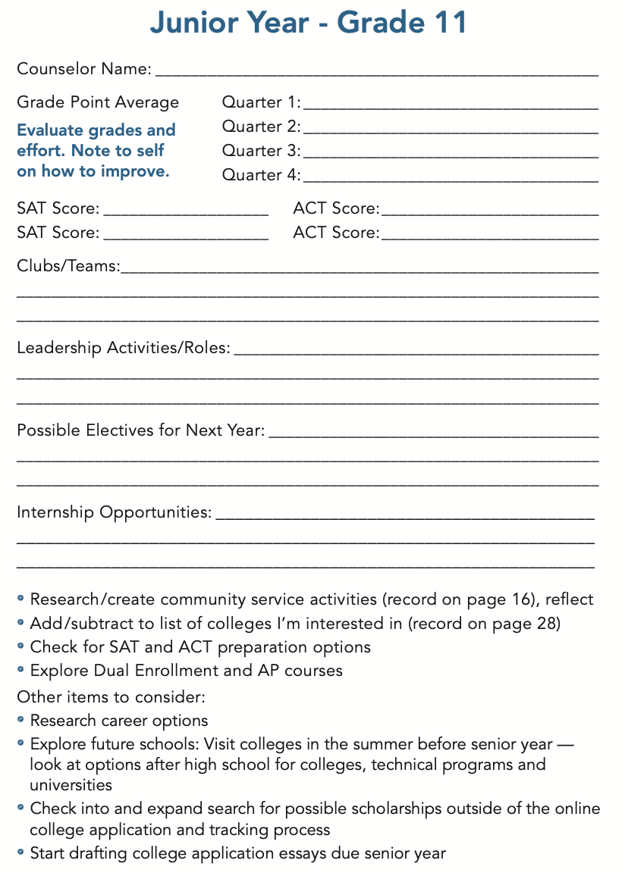
PLAN YOUR SUCCESS: JUNIOR YEAR
SHARE EXPERIENCES:
Let’s talk about it!
Let’s discuss your progress!
Notes:
Students should use their transcripts or report cards to complete part of this page. Junior year- go through each event and review what clubs teams they are working on, any leadership roles, internships, community service…have students share in pairs or in whole group what they are doing. Allow students to share insights with each other on these.
Have volunteer students share if they’ve participated in clubs, and what they have done in those clubs. If they have had a leadership role, ask them to share what they’ve had to do. Allow students to ask questions of each other about clubs, teams, and leadership roles. Prompt students to ask questions such as if they would want to be a leader in their activities and what do they have to do to attain those positions. Ask for helpers to volunteer their ideas. Always support positive influencers and what that means in the class.
Have students research bullet points for further insight and planning.
Extension activities and time can be for researching scholarships. See facilitator guide for more information on this. Have students think about visiting local colleges. If a field trip is allowable in your school, try to arrange for these through the proper channels. See extension activity in facilitator guide regarding Financial Options for college.

Slide 11
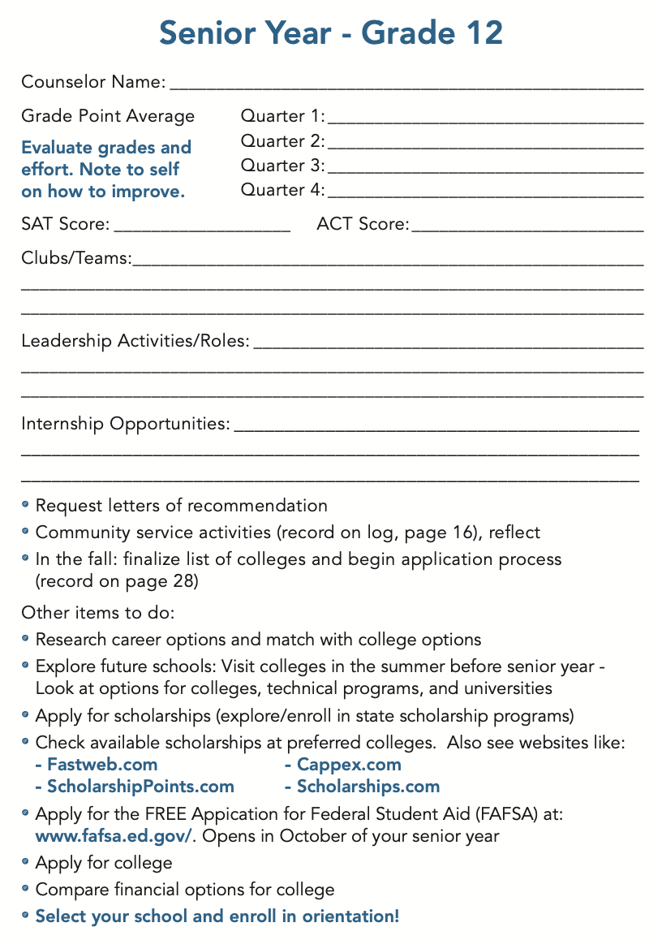
PLAN YOUR SUCCESS: SENIOR YEAR
SHARE EXPERIENCES:
Let’s talk about it!
Let’s discuss your progress!
Notes:
Students should use their transcripts or report cards to complete part of this page. Seniors should go through each event and review what club teams they are working on, any leadership roles, internships, community service…have students share in pairs or in whole group what they are doing. Allow students to share insights with each other on these.
Have volunteer students share if they’ve participated in clubs, and what they have done in those clubs. If they have had a leadership role, ask them to share what they’ve had to do. Allow students to ask questions of each other about clubs, teams, and leadership roles. Prompt students to ask questions such as if they would want to be a leader in their activities and what do they have to do to attain those positions. Ask for helpers to volunteer their ideas. Always support positive influencers and what that means in the class.
Have students research bullet points for further insight and planning. Explore and research any unfamiliar terms—have them share together in pairs and with the group. Finalize list of colleges they wish to apply to, further research career options, explore futures schools—with local school visits if available as a field trip. Verify the process to apply for scholarships. See facilitator guide for more information.

Slide 12

ACTIONS – PAGE 56
What We CAN Control
Notes:
Have students look at page 56 of their student book and reflect upon those things in their lives that they can control. You may ask for volunteers to share what some examples of what we can control.

Slide 13

ACTIONS – PAGE 56
What We CANNOT Control
Notes:
Have students look at page 56 of their student book and reflect upon those things in their lives that they cannot control. You may ask for volunteers to share what some examples of what we can control.
See the Four Corners activity (in Facilitator Guide) that helps students actively present those things that academically drive their success and represent areas that they can or cannot control. This activity is also supportive of English language learners, with ample chance to listen and speak with their peers and formulate their answers more clearly. After the class discussion, students should complete the reflection statement at the bottom of the student page and ask them why thinking about what they can and cannot control may help them as they plan for their future after graduation from high school.

Slide 14




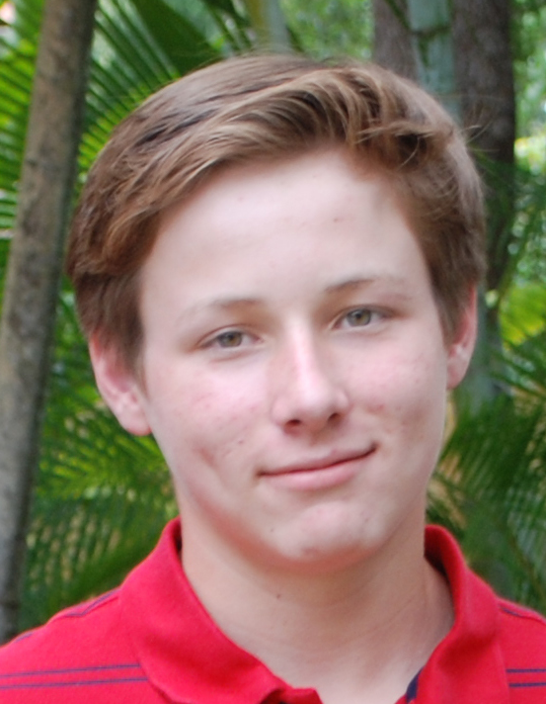
ACTIONS – NEXT STEPS
Notes:
These students are like you in that they are each going through different things in their lives right now. They may get good grades and sometimes struggle with some of the same things you do. Maybe they are attending a new school, or learning how to drive. Maybe they learned how to playing music on the guitar or the drums. Maybe they like to play sports, or hang out with friends. But at the end of the day, their goal is to graduate and to make something of themselves--in their personal lives and careers.
Now you have tools and resources, a support team, lists, notes, goals, and plans to make something of your life after high school graduation–
There are more things to learn, and we need to know how to look for the answers to the challenges we experience.
Students should have had the chance to explore their paths to success and the actions they are taking socially and academically to open more doors for themselves.
Depending on which order – The last chapter of the books: STRATEGIES could be next if not done in a previous session. Let students know:
The next session is called STRATEGIES and students will be analyzing how they currently study and how they can improve their study skills to maximize the control they have over their academics, and open more doors for their future success.

Slide 15
INSPIRATION
DETERMINATION
EXPECTATIONS
ACTION
STRATEGIES
A Path for Students’ Success
Notes:
Students should have had the chance to explore their paths to success and the actions they are taking socially and academically to open more doors for themselves.
Depending on which order – The last chapter of the books: STRATEGIES could be next if not done in a previous session. Let students know:
The next session is called STRATEGIES and students will be analyzing how they currently study and how they can improve their study skills to maximize the control they have over their academics, and open more doors for their future success.

