Slide 1


INSPIRATION DETERMINATION EXPECTATIONS ACTIONS STRATEGIES
EXPECTATIONS
A PATH FOR STUDENTS’ SUCCESS
Notes:
Review with students the discussions that took place in the third session.
They included:
Understanding that what they want their future to look like helps them to determine their short and long term goals
Developing a goal inventory
Matching career desires with goals
Finding their personal support team
Realizing their personal traits and matching these with possible careers
Invite any questions or comments about the previous session- including a comparison of what they thought their personal traits were and how those matched or differed with what their family members gave them as their traits. Also, if they learned something new about what others thought they would be good at.

Slide 2

EXPECTATIONS OF ACADEMIC CAREER OPTIONS
High School and then...College? University? Technical School?
What You Want to do Determines Your Next Steps!
Notes:
Review the definition of Expectations - also see Multilingual Glossary of Concepts.
It is defined as a strong belief that something will happen or be the case in the future (learnersdictionary.com).
Education options after graduation are clarified with a confirmation on where they are in their schooling and what comes next. Students should be refreshed about the following, depending on whether they are in middle or high school:
. Middle school students need to understand what going to high school means, what new options are available to them, such as electives, clubs, student government, sports, etc.
. High school students should be clear about what different education tracks they may be able to choose from, depending on what they want to study.
You may want to take a hand poll of the class as to whether they know which track they are going to take and if they understand the differences between each.

Slide 3

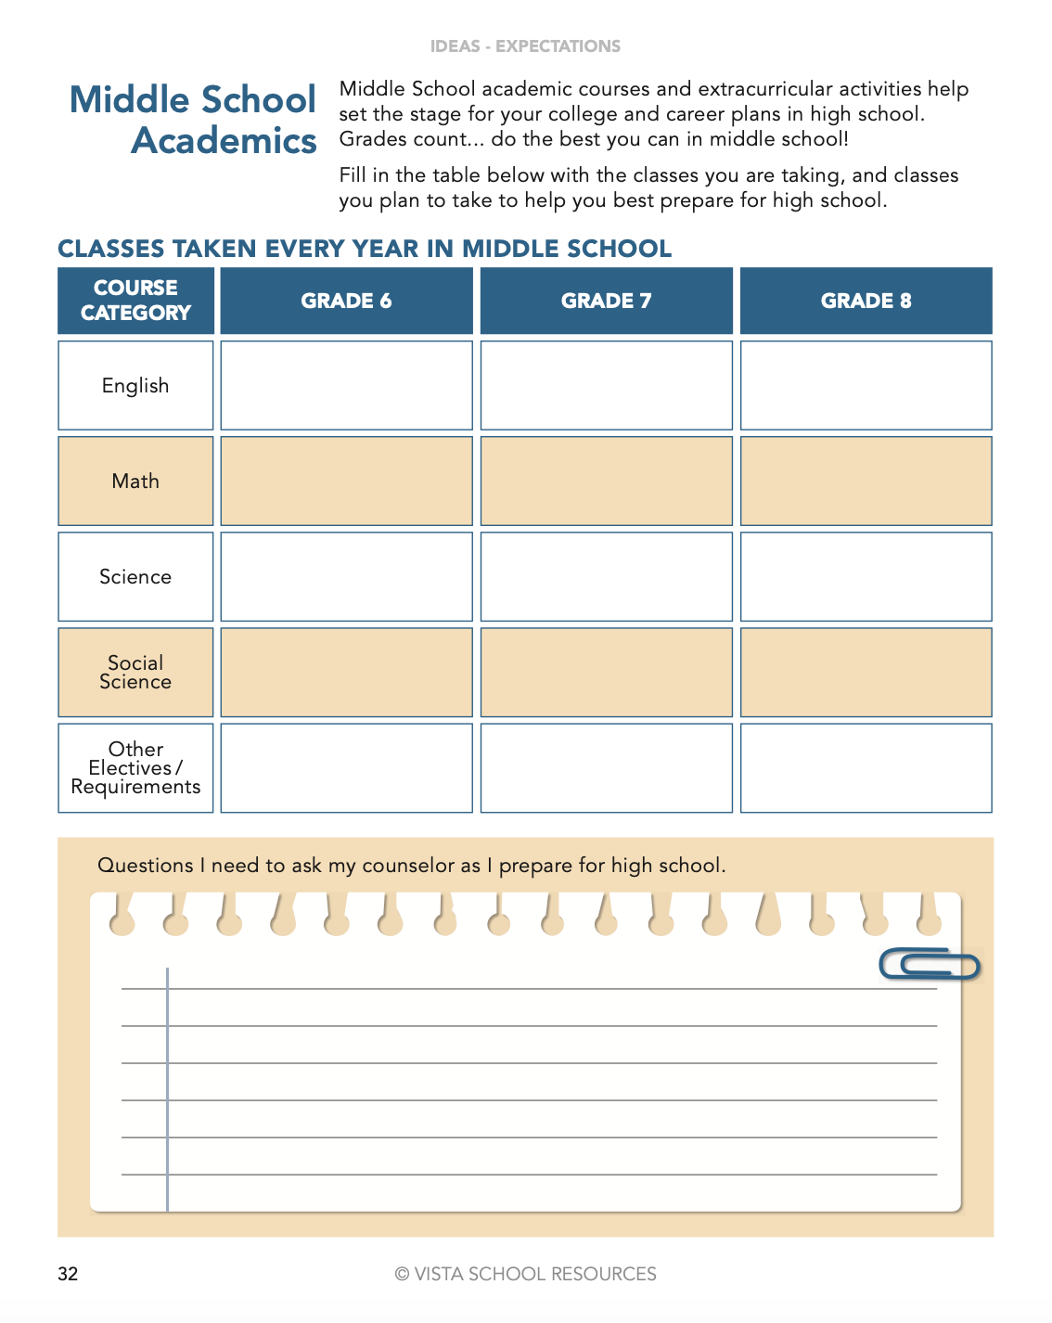
EXPECTATIONS: NEXT STEPS
Notes:
High School Students can look back at the classes they took in middle school if they would like to know how those classes helped to determine their high school path.
For middle school students: They can flip to page 32 to write out their middle school academic course track. Then they should flip back to page 25 in the student book and have a brief discussion about the colleges that are in their immediate area. They should be invited to share whether they have siblings or relatives who they know about who have attended college and share where those relatives attend. A running chart can be made, notes taken, and group discussion about who they know about who has attended college, near or far. If there is a lack of examples, the facilitator can share personal experiences about their post-secondary education track that would help students understand the pathways to getting a degree.
Have them discuss as a group the colleges in their proximity on page 25.
Review the courses middle school students lled in with the classes they took on page 32 of the handbook and have them expand with detail as to the course title. Sometimes they may be in U.S. History for Social Science and Algebra I for Math (as opposed to Math for 6th, 7th, and 8th).

Slide 4


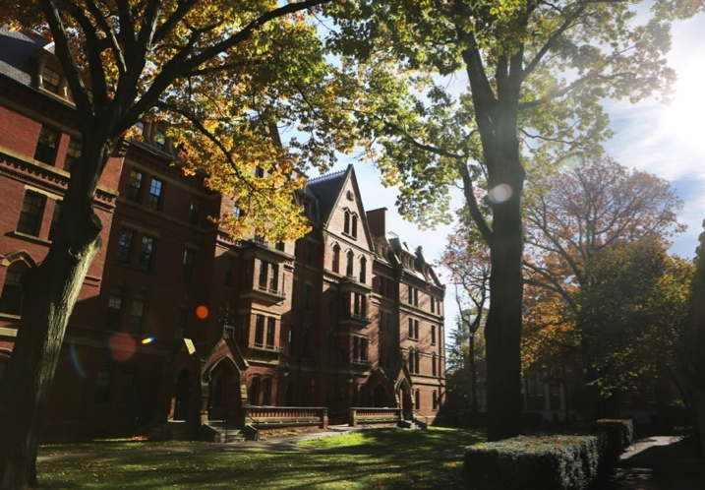



EXPECTATIONS: NEXT STEPS – PAGES 25 & 26
Commuting vs Going Away? What Degree Do I Want?
Think About What Options You Have
Notes:
For high school students: Use the pictures on this slide to begin discussion of types of options matched with types of schools. For example, military enlistment vs. firefighter, vs. doctor, vs. businessperson.
Continue reading on page 25 and ask students: Do you understand the different types of colleges that are available and how each is defined?
Ask for volunteers to read about Education Options After Graduation from their student book on page 25.
Ask students if they understand the different types of colleges that are available and what each one offers. Have students look up these definitions and contribute to the list of colleges and universities that are in or near the city or town they live in.
Group Share Review the definitions and the differences by prompting a discussion after reading page 25: What is the difference between a Technical School, Community College, College, and University?

Slide 5
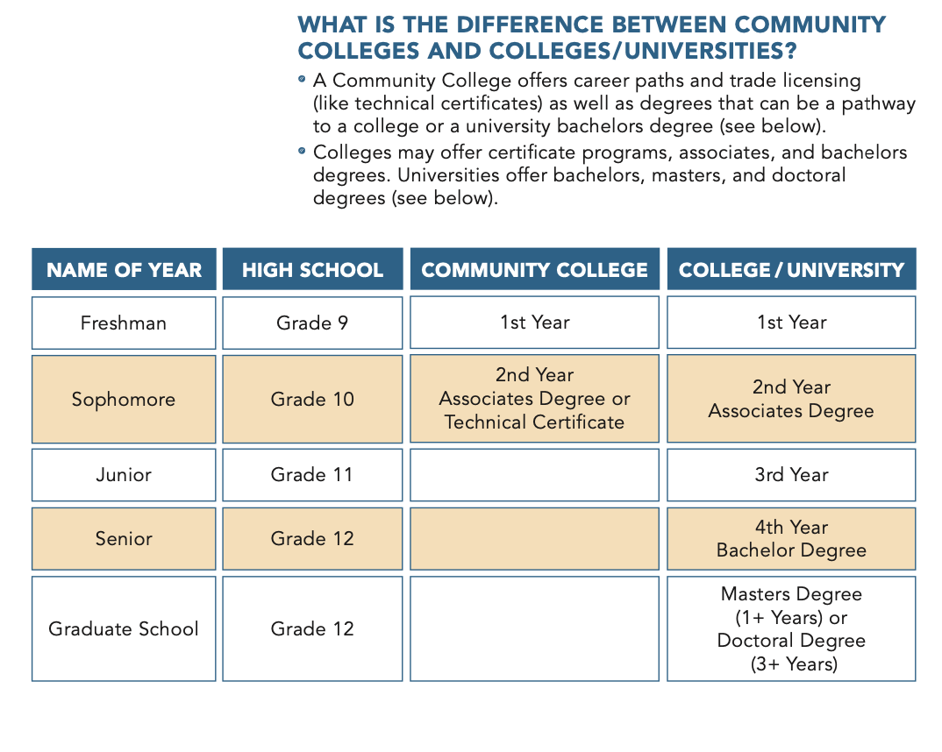
EXPECTATIONS IN MY FUTURE – PAGE 26
What kinds of careers are needed at different college levels?
Goals help determine who, what, and where
you want to be in
the near or distant future.
Notes:
Remind students about the goals they spent time thinking about and what level after high school they need to aim for. Types of colleges and degrees can be further clarified by referencing the table on student book page 26 showing the different years and degrees attainable. Note the names for each year, freshman- senior.
Group Share Invite discussion for students to demonstrate what they already know and if they understand the difference between technical schools, community colleges, and universities. Ask them to think about what kind of institution they want to attend and have them spend time researching the questions on page 26. Students in high school will benefit from doing some additional research on what types of institutions are available for them to possibly attend and the differences on the types and academic degrees they offer.
Extensions and Supports: There is an extension activity (with student reproducible page) in the Facilitator guide to offer the opportunity to do research on types of schools and degrees they offer. Invite discussion for students to demonstrate what they already know and have learned about the differences between technical schools, community colleges, and universities. Research extension activity in Facilitator Guide to research Higher Education options. There is also a Gallery Walk activity to promote students awareness of the different types of institutions and what they and their peers know about it.

Slide 6

EXPECTATIONS IN MY FUTURE – PAGES 27-28
Visit colleges personally or online. Ex: www.youvisit.com
Notes:
In addition to determining the right type of schools to explore, you should also check for the right fit academically. An academic fit means that these schools offer the area of study, or major, that you seek and that your qualifications match the schools’ requirements.
Read pages 27 and 28 of the student book together and investigate virtual college visits. Tell them to complete the list in their handbook of 10 possible colleges they would like to apply to on page 28.
If it is possible to go through a college visit as a class, model how to explore a virtual online as a class.

Slide 7

EXPECTATIONS: THE RIGHT ACADEMIC FIT – PAGE 28
REACH, MATCH OR SAFE
SCHOOL?
Where would I like to apply?
Where are my best chances?
Where am I sure I can attend?
https://www.usnews.com/best-colleges
Notes:
Review the page with students and clarify the definition of a reach, match or safe school. Have students research the possible safe and match schools near them from page 25 or check the list on page 28. They may also research schools near them or in another area.
Model how to classify a reach, match and safe school. Ask for a school name and go through the process of checking what it needs to be a reach, match or safe school. Reference the research previously done on the schools or model researching on the school website to get the needed specifications. Students can also try searching on this site: https://www.usnews.com/best-colleges for ranking and acceptance rates.

Slide 8

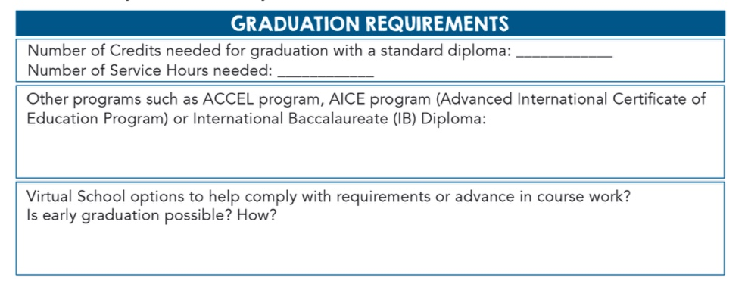
EXPECTATIONS: GETTING TO COLLEGE/COLLEGE PREREQUISITES
What Do I Need to Graduate
From High School?
Notes:
COLLEGE PREREQUISITES
Students know they have to finish high school to go on to college but they may not always know the prerequisites. Review this section about the College Readiness Plan and explain acceptance rates.
A selective college is simply a college that does not admit everyone.
The percentage of students admitted is what selectivity is measured by. The lower the percentage, the more selective the school is. This is not necessarily an indicator of how good the college is. A very good college can have high acceptance rates. However, those colleges where the selectivity is very high are usually highly desirable schools. That is because there is a high number of applicants vs. the number of students the college is capable of admitting.
COLLEGE READINESS AND HIGH SCHOOL GRADUATION REQUIREMENTS
This is an opportunity to review the local/state requirements for graduation. It also exposes students to the fact that there are other opportunities for them to get remediation, accelerate or get different types of high school diplomas. Based on your students’ needs, you can go deeper into these topics.
Group Share Review the basic requirements listed in the student book on page 29.

Slide 9
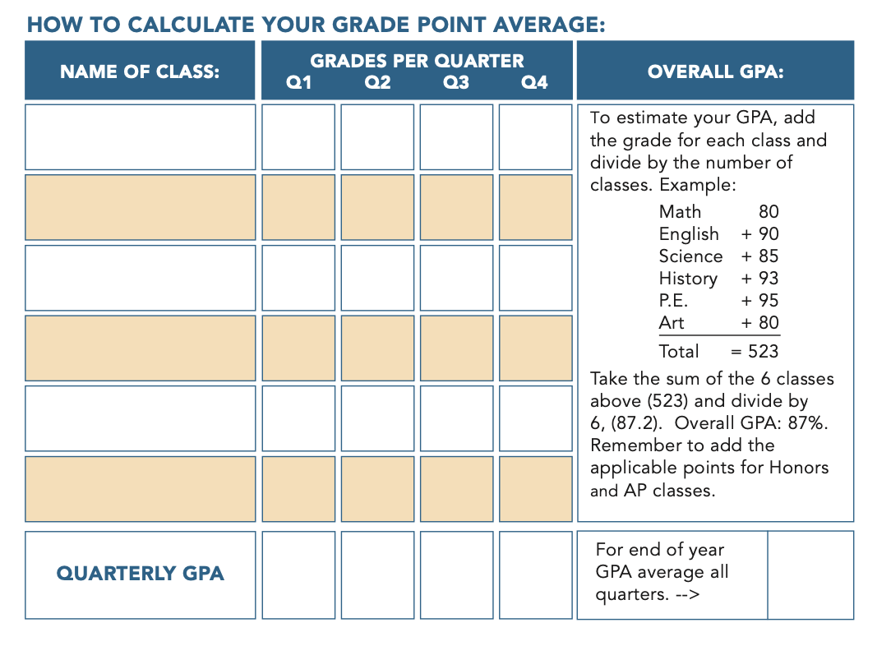
EXPECTATIONS IN GETTING THE GRADES – PAGE 31
Notes:
GETTING THE GRADES!
In order to graduate, students must pass their courses. Review requirements including grade point average and end of course requirements for your state.
Review the definition of GPA and then review page 30 together. Explain that when they hear the term 4.0 grade point average, they understand that this means the student has an overall A average. Anything above that grade point average shows that the classes taken were Honors level or higher.
Note: Review page 30 of the student book together and ask students if they have any questions. Model an example of a GPA calculation and then have students practice guring out their GPA for a class, or for all their classes.
Review the terms Report Cards and Transcripts on student book page 31. If a sample report card is available (with name and any identifiers blocked out) show students for them to review as well as a transcript. This will allow students to know what to expect to see.

Slide 10

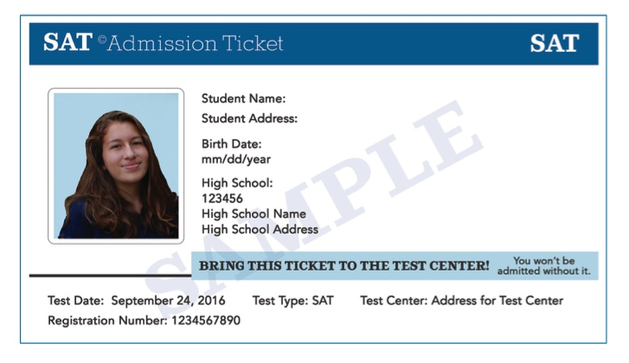
EXPECTATIONS: THE COLLEGE APPLICATION PROCESS
Entrance Exams Types of Applications College Essays Student Resumes Recommendation Letters Application Deadlines
Registering for SAT or ACT:
.
.
Is there a fee to take the test?
What do you need to take with you
the day of the exam?
How can you prepare for the test?
Are there any other entrance
exams needed?
.
.
Notes:
COLLEGE APPLICATION PROCESS - COLLEGE ADMISSIONS
Have students review the information on pages 34, 35, and 36 individually or in pairs. For students who need extra supports in pulling key information, ask them to answer these questions.(at your discretion):
Name three parts to the college application process (the application, college entrance examination (list types), providing your graduation requirements fulfilled)
. How does one register for a college entrance exam?
. Is there a fee to take this test?
. What do you need to take with you to the college entrance exam?
. How can you prepare for this test?
. Are there any other college entrance exams needed?
Are there different types of college applications (name three possible ways to apply to a college).

Slide 11

EXPECTATIONS: THE COLLEGE APPLICATION PROCESS
Entrance Exams Types of Applications College Essays Student Resumes Recommendation Letters Application Deadlines
Notes:
Are there different types of college applications (name three possible ways to apply to a college)- review page 36 of the student book

Slide 12

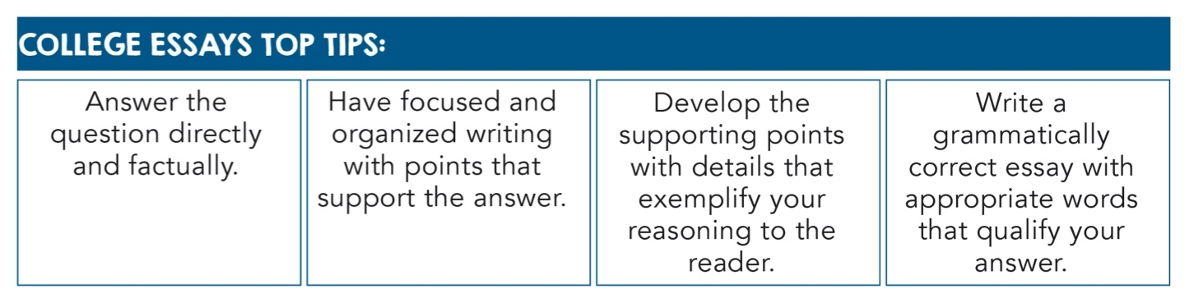
EXPECTATIONS: THE COLLEGE APPLICATION PROCESS
Entrance Exams Types of Applications College Essays Student Resumes Recommendation Letters Application Deadlines
Notes:
The College Essays
Colleges and universities may have prompts in their online applications that are answered in the or o essa s. hese are bene cial to o as o r responses can help o stand o t in a co petiti e eld o applicants. o can s all prepare o r essa s in ad ance modify them for each school you apply to, and copy and paste your answers from a word processing document program like Microsoft Word. Take your time to craft a complete answer, and insert it into the application.
There are different types of essay prompts. Some will ask you to share more about you, your life experiences, your interests, and goals. Some will inquire as to why you are interested in that particular college. Others may want to know how well you are able to respond to their open-ended questions utilizing your experience and knowledge. No matter the questions you are asked, reply with factual information, stay focused, and make sure to check your grammar.
Ask your support team or mentors to proofread your essay.

Slide 13
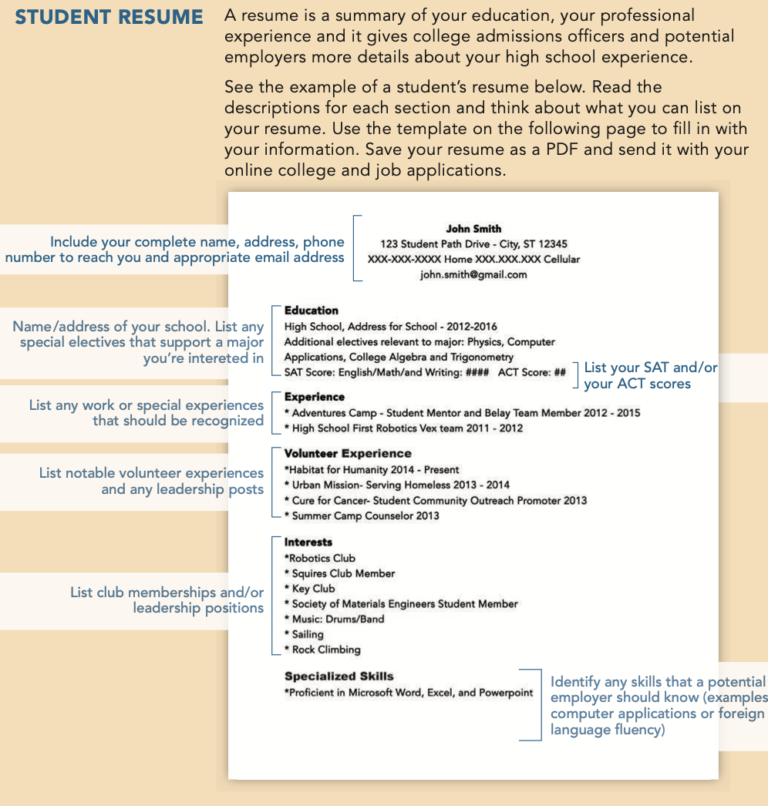
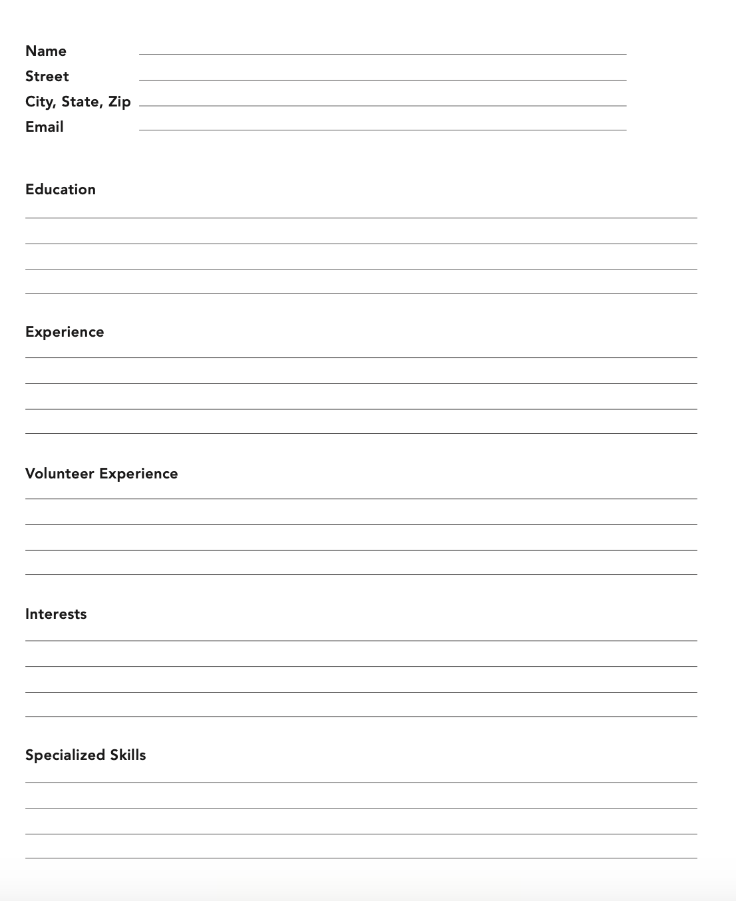
EXPECTATIONS: THE COLLEGE APPLICATION PROCESS
Entrance Exams Types of Applications College Essays Student Resumes Recommendation Letters Application Deadlines
Notes:
This is a sample resume that students can refer to and is shown in the student book on page 38. Review each section and point out what should be included. This should make students aware of what they need to add to their repertoire. There is a template in the student book that can be filled out. Have students do a rough draft before writing in their books if possible. This can change, but it is an exercise in practice to see how much they can fill in at this point and demonstrate where they can improve the depth of their offering on their resume. Encourage students to spend a few minutes thinking about what they can add to their resume. Have students share with a partner and get feedback.

Slide 14

EXPECTATIONS: THE COLLEGE APPLICATION PROCESS
Entrance Exams Types of Applications College Essays Student Resumes Recommendation Letters Application Deadlines
Who Can Write My Recommendation Letters?
Find out about:
Early Application
Early Action/Early Decision
Notes:
College Application Deadlines:
Read the rst paragraph aloud together as a class. Provide the opening date when applications begin to be accepted for college. If it’s possible, go online as a group to the nearest university and show students how to search for deadlines (including for application, registration, etc.)
De ne:
. Early Action Application- Usually means they are most interested in that college but are . not committed.
Early Decision Application- These are binding decisions upon acceptance to the college or university.
Recommendation Letter Notes:
Ask students to add a section for their recommendation letters in the notes section at the back of their student book. Notes should include which teachers to ask and possibly a draft of your interests and career goals. Remind students that they should select a teacher they had a class with junior or senior year of high school unless, they have maintained contact through clubs or sports.
Getting “everything” ready- application, official transcripts, application fees, of cial test scores (ACT, SAT) sent to colleges, etc.

Slide 15
INSPIRATION
DETERMINATION
EXPECTATIONS
ACTION
STRATEGIES
A Path for Students’ Success
Notes:
Students should feel more comfortable with what to expect after high school their options in types of schools, how to research schools, what they need in high school and how they should be preparing for the next academic steps: for the types of careers they may be interested in. Students should be building their student book with material that will help them in the application process, from which schools to apply, to their own qualifications like Grades, College Entrance Exams, Deadlines, Resumes, and Recommendation letters.
Let students know:
The next session is called ACTIONS and you will be looking at what you’ve done in high school more closely and how to plan so that its easier to fulfill the requirements and the application process!

