Slide 1


INSPIRATION DETERMINATION EXPECTATIONS ACTIONS STRATEGIES
DETERMINATION
A PATH FOR STUDENTS’ SUCCESS
Notes:
Review with students the discussions that took place in the second session.
They included:
Completing the Welcome page of the student book
Understanding where you are at in school (what level, and what is to come)
Discussing Academic and Value statements
Evaluating where you are on the College and Career Readiness Continuum
Contemplating what being successful means
Thinking about what we learned
Invite any questions or comments about the previous session

Slide 2


DETERMINATION OF PERSONAL AND ACADEMIC GOALS
Talk About It
.
How can I reach my goals?
How you imagine your
future will impact
CHOICES & GOALS
Notes:
Earlier in the program students reflected on what being successful meant to them. Ask them to recall what they thought being successful was in life and in their careers. Ask students to look at student book page 20 and answer: How can I determine my personal and academic goals? They need to understand that who they want to be will drive them to reach the goals as grown up. Review with students he definition of the word Determination from the glossary.
Time permitting, complete the developing goals discussion and activities. They can aid students in developing their goals and choices for their future. They are in the Facilitator Guide.

Slide 3

DETERMINATION IN PLANNING YOUR FUTURE
MAKING GOALS MEANS HIGHER ACHIEVEMENT
Notes:
Remind students about the previous discussion--that whether they were in middle school or high school, they might be inspired to accomplish different goals in life. Whether it’s for a career, job options, or family choices, having an idea of how they saw themselves in the future could have an impact on how they got there and what they chose to become.
A goal is the object or aim of an action (Locke and Latham 2012). If people make higher level goals they will succeed 250% higher achievement than people with the easiest level goals (Locke 1967). Having multiple goals is also possible. Prioritizing goals and working according to what is doable is key (Locke and Latham 1990).
Facilitator,
Explain: Goals help you determine who, what, and where you want to be in the near or distant future.
Ask: Who do you imagine yourself to be personally and professionally with your peer partner?

Slide 4

DETERMINATION IN PLANNING YOUR FUTURE
Who do you imagine yourself becoming
personally and professionally?
Goals help determine
WHO, WHAT, and WHERE
you want to be in the near or distant future.
Have multiple goals and prioritize.

Slide 5
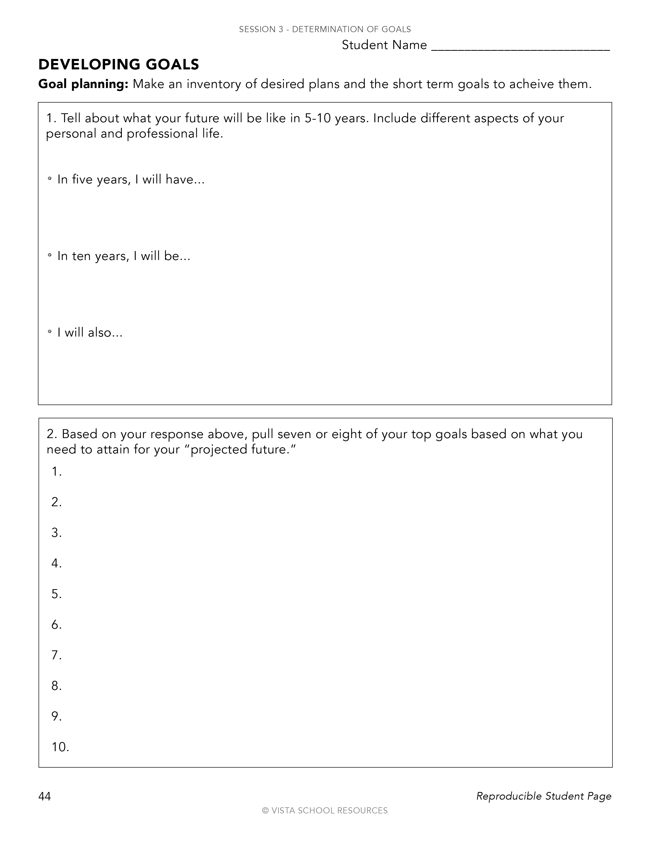
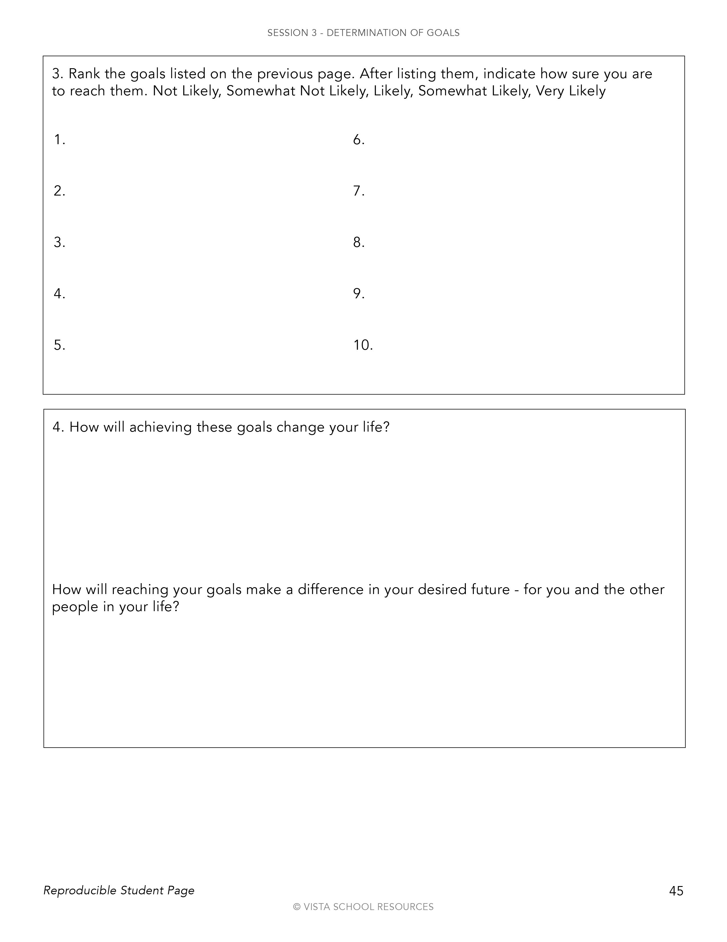
DETERMINATION IN PLANNING YOUR FUTURE
Notes:
The following activity is designed to have you think about and set up some initial goals about your future. Part of this is how you imagine your future will be. Know that the goals may change as you have new experiences. However, if you have made a goal, or have an idea of who, what, where you want to be, you can at the very least, move in that direction and have opportunities to discern what works and what doesn’t for you.
Ask students to work with a partner or small group to discuss this: Tell about what your future will be like in 5-10 years. Include different aspects of your personal and professional life.
. In five years, I will have... . In ten years, I will be...I will also... (This activity is expanded in the facilitator guide- with student reproducible pages)
Based on your response above, list the top goals based on what you need to attain for your “projected future.” Then, rank them. Facilitator can model what this may sound like.
Are their smaller goals, or sooner than the previous goals? You may scale up to that goal with sub-level (smaller) goals like walking a half-mile, then a mile, then running and walking a mile, then running and walking a mile and a half, then running a mile and a half, then run walk the two miles, then run the two miles. That’s actually seven steps before getting to run two miles. And we have not even discussed how often or how long this could take to build up! The same can be said for a professional goal or finding out more about a career.

Slide 6

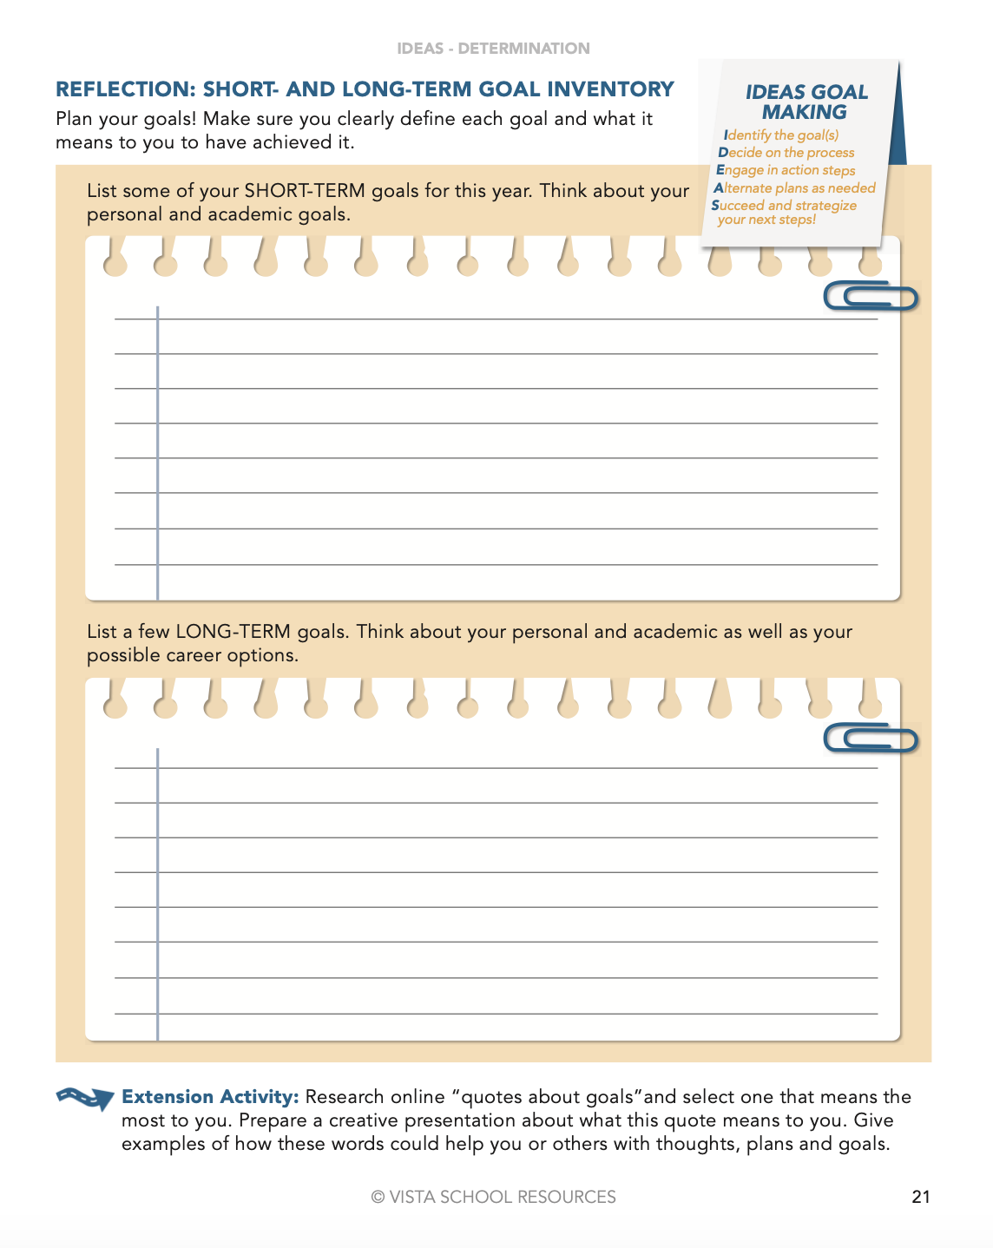
DETERMINATION OF GOALS: AN INVENTORY – PAGE 21
Notes:
Help students list the few short-term and long-term goals they have for the year.

Slide 7

DETERMINATION OF GOALS AND GETTING THE SUPPORT YOU NEED
Who is part of your personal support team?
Notes:
Setting goals - both long and short term - require actions on students’ part. It’s important to know that some actions require assistance from adults. These people are their personal support team.
How can a personal support team help the students? - ask for volunteers to suggest areas they will need help with such as:
Academic requirements, college entrance exam support, joining clubs, community service, and other questions that will come up along the way.
Ask students to think who are the adults that they look up to. Then ask them to think about the list of potential support team members listed on student book page 22 and what the school counselor can help them with.
Have students list the school counselors as well as others at school that they should be able to reach out to for assistance (on page 23)
Also, if they have difficulty reaching that person, have students share ideas on how to overcome that challenge.

Slide 8

DETERMINATION: PERSONAL TRAITS
What am I GOOD at?
What TRAITS do you see in me?
Notes:
Relay to students that understanding how they are perceived by others is important as they determine their goals, and what they want to be personally as well as in their career. Have students go home and ask their family members for their personal traits that they see in them.

Slide 9
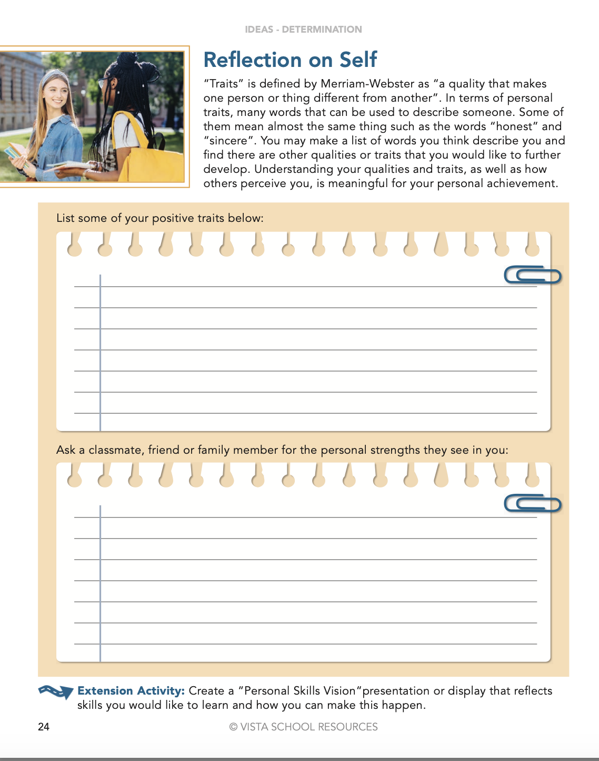

DETERMINATION: PERSONAL TRAITS – PAGE 23
Writing
Notes:
REFLECTION 3: PERSONAL TRAITS
Student Book Page 24
Review the definition of traits. Model for students an example of your own positive traits. Extend into the word “strengths” and share how positive traits can be a strength. Ask students to think about what they are good at and how that can be described as a positive trait.
For example, they try hard in sports. Maybe they can be described as competitive, persistent, and determined.
Tell students they are to list their positive traits and what they are good at. At home, they can also interview family members for feedback and additional information. Ask them to list their positive traits that they think their family, friends, and classmates value in them.
Return to page 15 in the IDEAS Handbook and see if there is a match between their strengths and qualities and what subjects they like in school and with any of the sample careers listed on page 14. Have students work in pairs to get input from each other on what their peers see as positive traits in their classmates as well as possible careers that their traits may be best inclined for. Tell them they may be helping to pick what they may like to study for a career! See Snowball activity for English Language Learners that would be good for a mixed class of students to help them understand traits and about their peers better. Its an active way to get students thinking positively about what they are like, and what others think they might be good at.
Share with students that there are online assessments and career explorations as well as conversations with their mentors will also help.

Slide 10
INSPIRATION
DETERMINATION
EXPECTATIONS
ACTION
STRATEGIES
A Path for Students’ Success

