Slide 1


INSPIRATION DETERMINATION EXPECTATIONS ACTIONS STRATEGIES
INSPIRATION
A PATH FOR STUDENTS’ SUCCESS
Notes:
Review with students the discussions that took place in the first session.
They included:
Completing the Welcome page of the student book
Understanding where you are at in school (what level, and what is to come)
Discussing Academic and Value statements
Evaluating where you are on the College and Career Readiness Continuum
Contemplating what being successful means
Thinking about what we learned
Invite any questions or comments about the previous session

Slide 2


INSPIRATION FOR COLLEGE AND CAREER READINESS
Talk About It
.
What is to be actively involved on college campus?
What online assessments
help you be college and career ready?
What are some ways to explore careers?
What is community service?
.
.
.
Notes:
Say let’s look at these and find out what we know about them:
What is Active Involvement on Campus mean? – invite volunteers to share what they think it is.
What kind of online assessments can help me be college and career ready?
What are some ways we can explore careers?
What is community service?
If it helps to ask them to work in partners or whole class volunteer discussion.. Brief as an introduction- anticipation conversation.

Slide 3
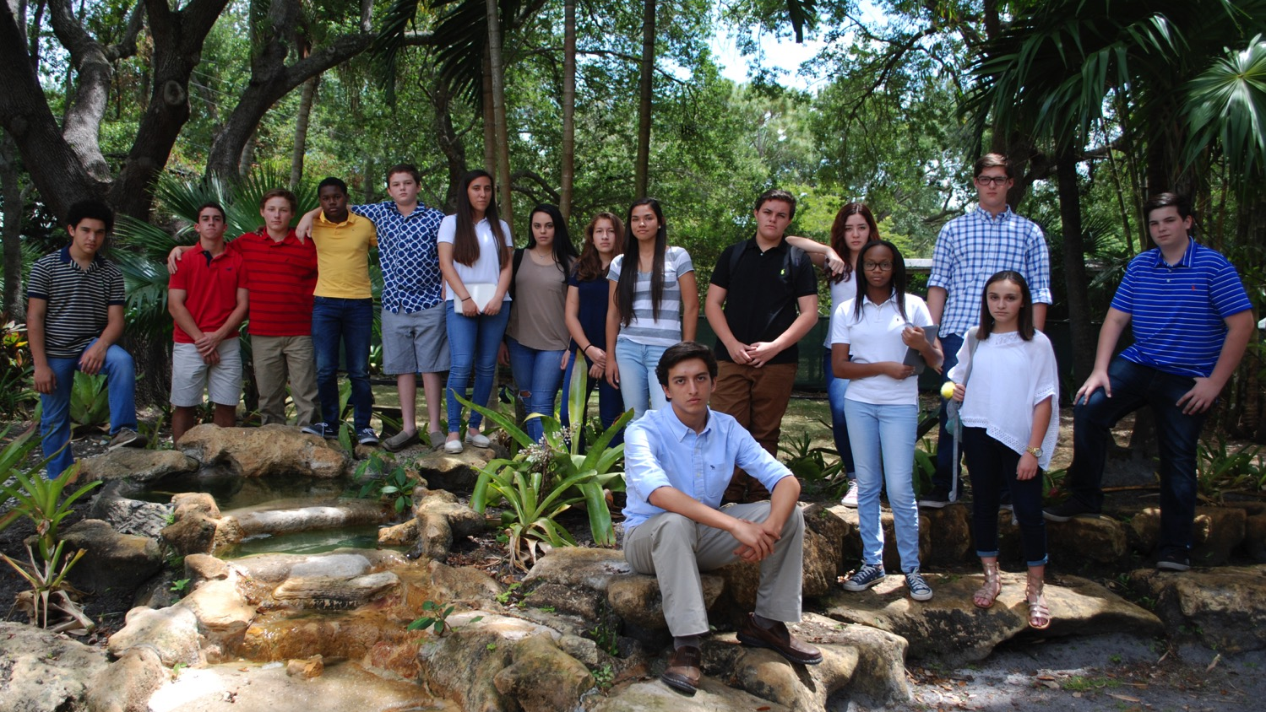
INSPIRATION IN PLANNING YOUR FUTURE
Get Involved in Campus Activities!
Notes:
The first chapter after the introductory session is called Inspiration
Relay to students that whether they are in middle school or high school, they may be inspired to accomplish different goals in life. Whether it’s for a career, job options, or family choices, having an idea of how they see themselves in the future can have an impact on how they get there and what they choose to become.
Ask: Where can you find inspiration in school?
Read the first three paragraphs on page 10 of the student book together.

Slide 4
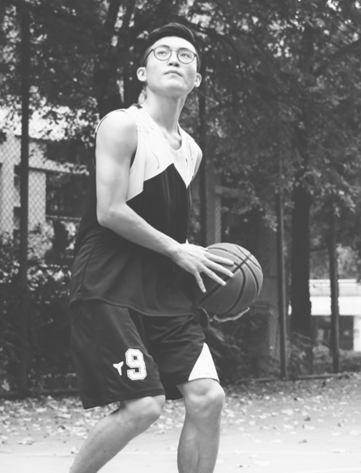
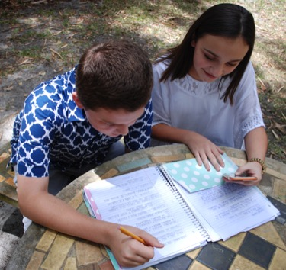
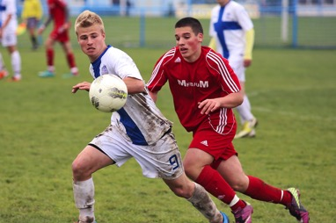
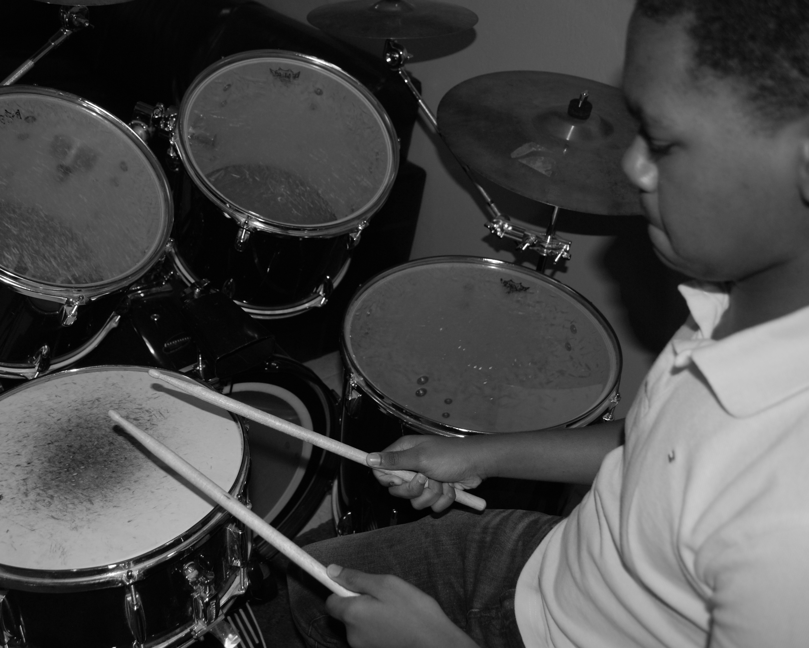










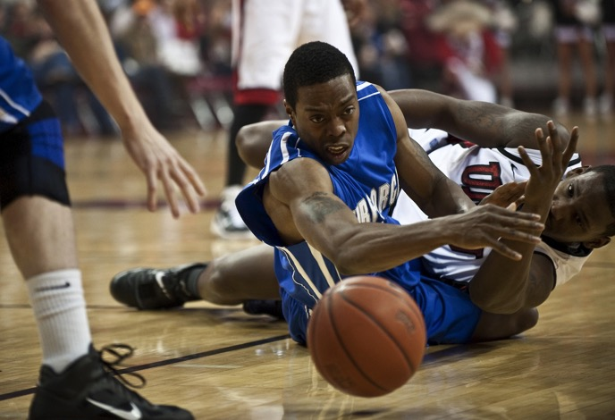
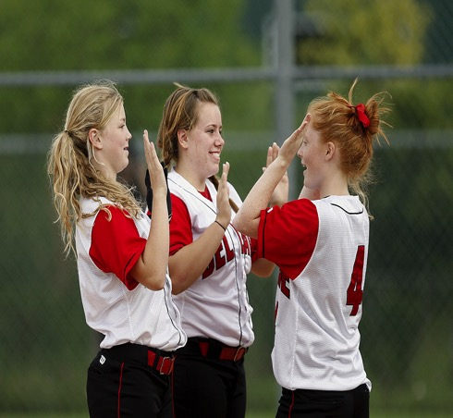
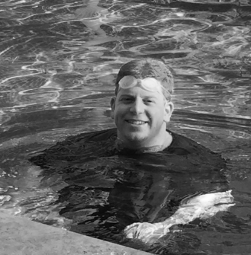
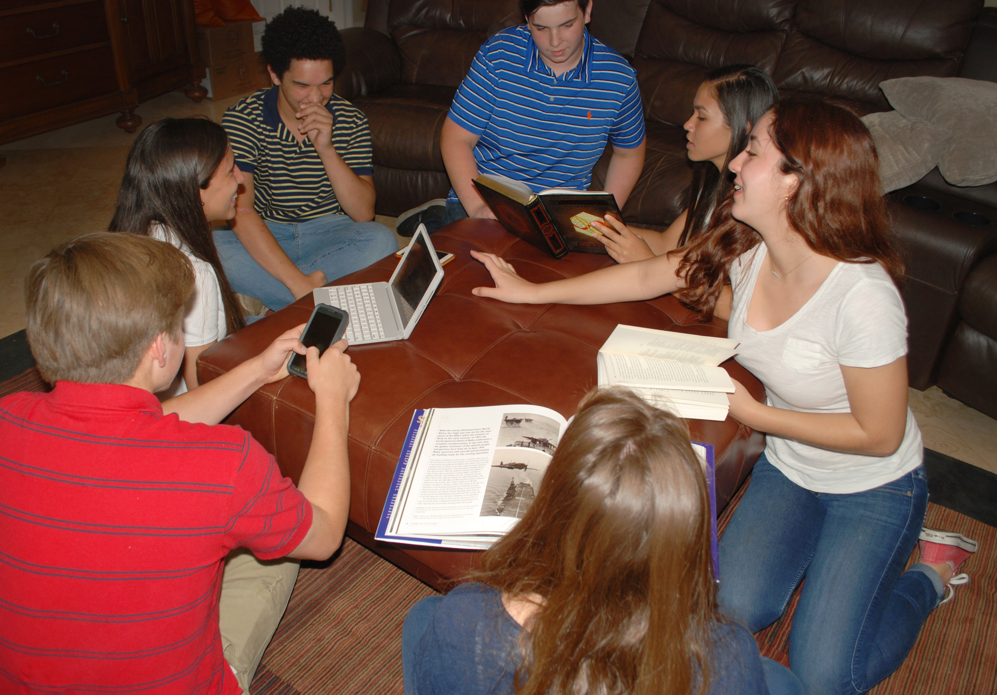
INSPIRATION – WHERE TO FIND IT
Join One of These Clubs
See Your Student Book for More Options
Notes:
Have students raise their hands if they are a member of a club on campus and ask for volunteers to explain what the club’s objectives are.
Review the club examples listed on page 11 of the student book and find out if students know what all these clubs are, whether they have those clubs on campus, whether there are members of any of these clubs present in the room. If they do have members, ask them to share how they joined the club and open up questions about it.
Ask them to share who are the leaders of those clubs and how did they get to be leaders. Leadership positions help them in many ways.
Tell/ask students: If you do your best academically, and start to plan, you will have more choices in what you do. What kind of options do you have in school? Some clubs are subject oriented, like math, or journalism (writing). These clubs require higher academic standing. This helps give you more options to participate.
Have students brainstorm with a partner about the clubs on campus using the list on page 11- what would be interesting to them?

Slide 5

OTHER SOURCES OF INSPIRATION
Club / Contact Name / Meeting Room:
See your student book pages 11-12.
Mark down what clubs you are interested in joining, the name
of the contact for the club and the room that they meet in.
Make sure you find out when and where they meet!
Notes:
After sharing with a partner (or in small groups), ask them to record what clubs they are interested in participating in or finding more information about.

Slide 6

OTHER SOURCES OF INSPIRATION
Research Online What Career is Right for You
See your student book page 13
Notes:
Other sources of inspiration for your academic and career goals in life can come from research. You may search online and also check out books in your school library about types of careers. You may even look up well-known people or public figures who took those career paths and and out what they did to accomplish them. If you need help in the library, ask your school’s media specialist or school counselor.
Online assessments can help you think about what careers are available for you. There may be programs available at your school like Naviance (www.naviance.com), that help you explore your interests and strengths. Besides the research you do and the powerful online tools, what else is there in our lives that may help us choose a future career?
IF THERE IS A SCHOOL OR DISTRICT BASED PROGRAM FOR STUDENTS, TAKE THIS TIME TO EXPLAIN HOW TO USE IT.

Slide 7











EXPLORING CAREERS
See your student book page 13-14
Notes:
Connecting to the world around you and observing others’ jobs may lead you to your career! Exploring careers in our society can be a great inspiration. Think about your interactions with teachers, community helpers, family members, and everyone you have contact with. Is there someone in your life that you admire for their happiness and/or success? Is there a subject in school that you really enjoy learning about? Have you thought about all of the different job types needed to do everything in your city to work efficiently? There are things all around us that may influence our future plans!
A model inspiration to see how many and what careers are involved in our society is to observe what it takes to build a structure. The building you are in right now took a multitude of careers to make it happen. Contracts had to be written by lawyers and realtors to purchase the land. The money to buy and build was lent by a bank through a loan officer. Architects and engineers designed the structure. Contractors managed the electricians, masons, plumbers, and other specialists who built it.
The materials to build it were all created in different factories. Cooling and heating systems, were designed. Walls and ooring were constructed. The electrical components--lights, elevators, computers, and so much more were installed. Government inspectors had to make sure that it was built to the regulated safety standards. Many people had
an impact on this building’s construction and these are just some of the careers needed. There are many other people whose careers are based inside of the finished building such as: teachers, administrators, counselors, coaches, volunteers, secretaries, chefs, and custodians. These are some of the people who help it run efficiently so that students have a place to learn.
Notice what and who is needed to have hospitals, airports, roads, courts, a justice system, cable television, the internet and everything else around where you live. Service professionals provide protection and relief such as firefighters, police, and military services. Researchers and scientists and doctors are needed for medical cures and treatments. Personal inspiration is all around us if we take the time to notice who and what helps make our society function.

Slide 8

COMMUNITY SERVICE
See your student book page 15
Helps Others
Required for Graduation
Well Rounded
Students
Notes:
Community Service
Community Service means volunteering in some way to help the common good. Giving back to your community can be a rewarding experience and even help you see things that could possibly inspire your future career choices. Most schools have a minimum number of community service hours required for graduation.
As a student volunteer (through service-oriented projects) you can accumulate your service hours. How much you partake in service activities is important and usually serves as a great personal growth experience.
Ask the class if there is anyone who has completed some community service and ask them to share their experience. As facilitator, share any community service you have done.
Need help figuring out where to volunteer? Ask your support contacts and your school counselor for help finding volunteer activities related to your interests.
Sometimes there are opportunities to provide community service in your town or city that don’t necessarily require involvement in a club. You can search online “community service” + your zip code and different community service organizations will pop up. Ask for help from your parents or mentors to check them out first before committing or attending.
A well-rounded student is important to college admissions counselors. They want to welcome students in their colleges and universities who are doing well academically and also want to give back to their community.
Discuss what a well-rounded student means. Ask for volunteer answers. The definition of well rounded student has evolved. Not only is a student prepared academically, but also participated in activities outside of the classroom. Clubs and sports are part of that. Volunteering and being active in the community is another part. Finding something that particularly interests a student so that they can really develop and interest on passion is better than just being “busy” with lots of things to do. If you become more of an expert in an area that is more desired.

Slide 9

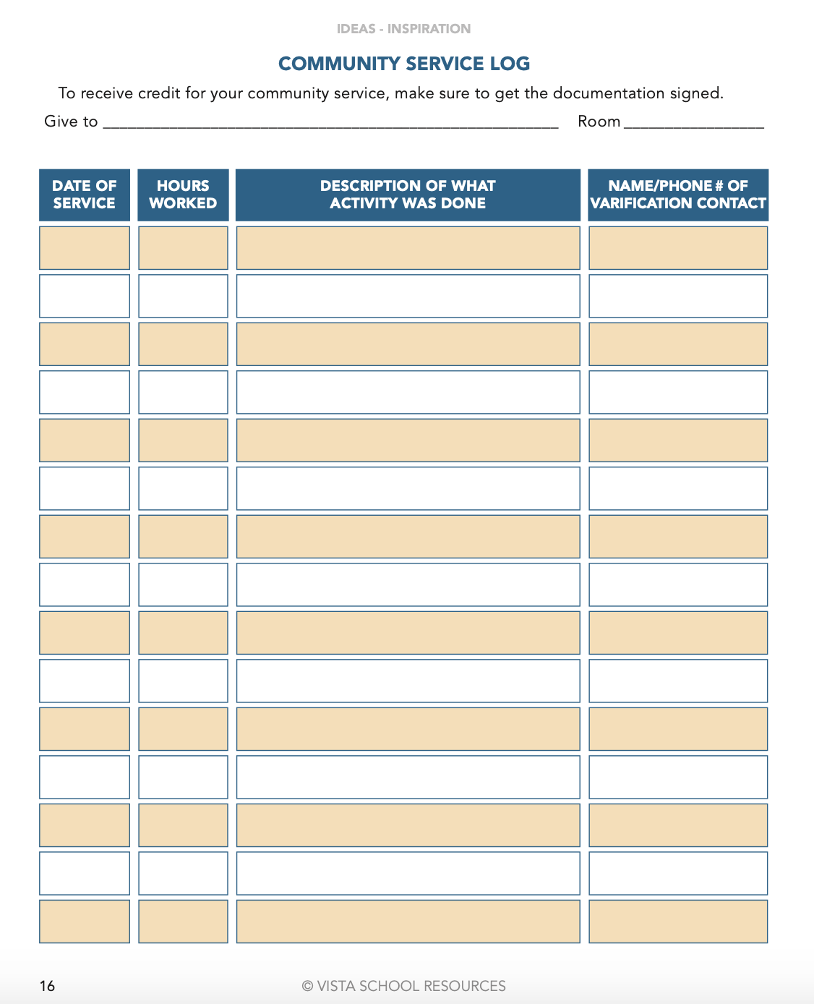
COMMUNITY SERVICE
Notes:
Keep a record of your service activities so that you get the credit you deserve for all you’ve done. Find the Community Service Log on page 16 of this IDEAS planner for you to enter your volunteer information. Refer back to this log when applying to college.
You may need a Community Service participation letter to be signed by the supervising adult for the service project. Make sure you get the documentation you need for your service credit.
Its really important to be able to share how the community service experience affected you or the way you think. Depending on the type of activity, whether its helping others or a nonprofit organization, its key to take notes after you performed the service so you can look back on what you did and reference it in your college essays if appropriate for the prompt. THIS is a factor to help differentiate you from others applying to the same school.

Slide 10

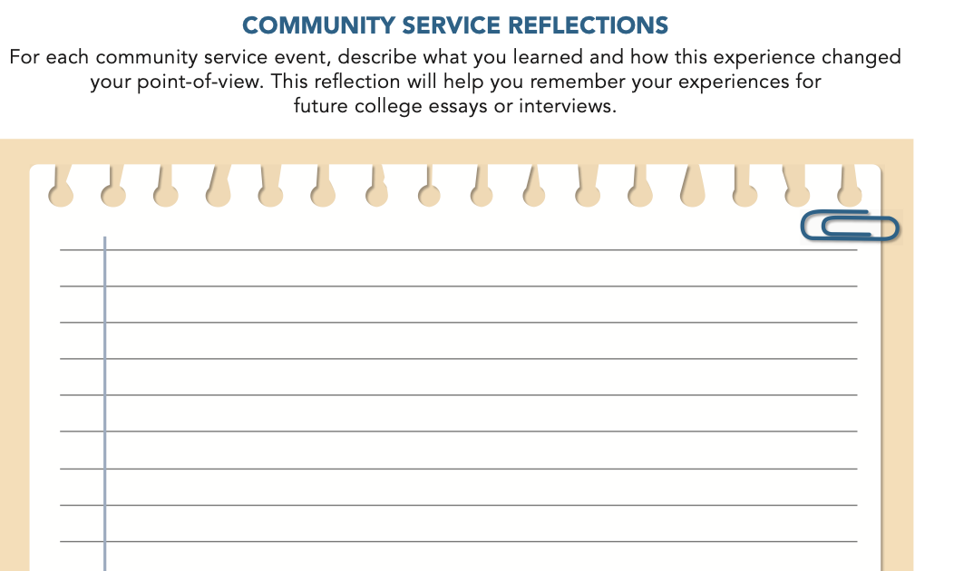

COMMUNITY SERVICE – PAGE 17
Writing
Notes:
Its really important to be able to share how the community service experience affected you or the way you think. Depending on the type of activity, whether its helping others or a nonprofit organization, its key to take notes after you performed the service so you can look back on what you did and reference it in your college essays if appropriate for the prompt. THIS is a factor to help differentiate you from others applying to the same school.

Slide 11

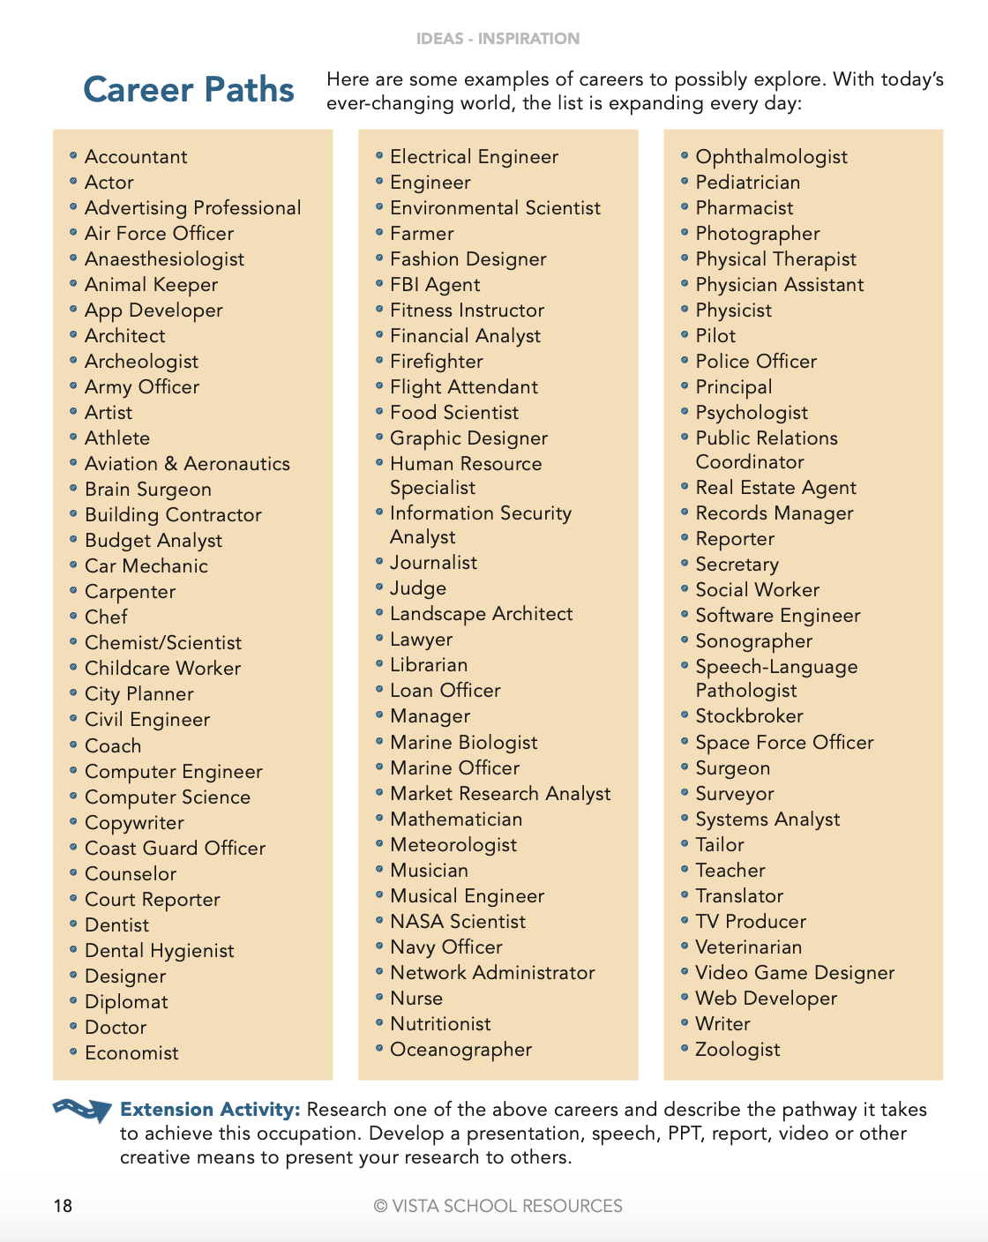
EXPLORE CAREER PATHS
Notes:
Share this with students:
Career inspiration comes from many places. We have looked at clubs to gather insight and experience in our interests. We have begun to notice our world around us, and the myriad of jobs needed to build buildings and run a society. We have thought about or experienced where we are needed and the impact we can have on others. Here is a list of careers to start thinking about. You can also research more about them.
**Have Students review the list with their partners and put a mark next to a career they don’t know about and have them look up the definition or description. Have students volunteer information to the class about two to three new careers they learned about.
On page 19 of the student book, explain the connection between subject areas and careers of choice. For example, I’m great at math and very interested in numbers; that’s why I find accounting and helping businesses keep track of their money and finances inspirational. Have students think about what they enjoy in any of their classes and try to make the connection with a career they may be interested in. Also, they are asked to list careers they MIGHT be interested in.
There is an additional extension activity in the facilitator guide

Slide 12
INSPIRATION
DETERMINATION
EXPECTATIONS
ACTION
STRATEGIES
A Path for Students’ Success
Notes:
Let students know:
The next session is called Determination and you will learn strategies to help make your dreams for a career a reality, with step by step goals.

