Slide 1


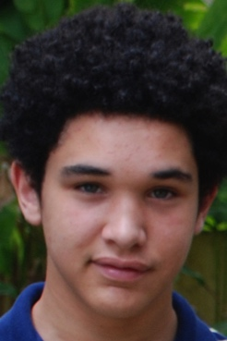


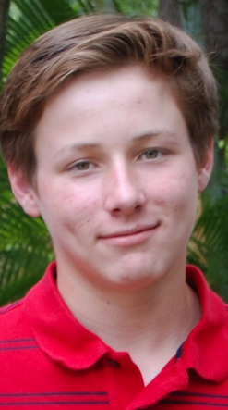

INTRODUCTION
Notes:
Relay to students: These students are like you! They are each going through different things in their lives right now. They may get good grades and sometimes struggle with some of the same things you do. Maybe they are attending a new school, or learning how to drive. Maybe they learned how to playing music on the guitar or the drums. Maybe they like to play sports, or hang out with friends. But at the end of the day, their goal is to graduate and to make something of themselves--in their personal lives and careers.
Explain to students: This program is going to give you the space to think about what you want to do. We will start wherever you are at right now.

Slide 2


TIME TO THINK ABOUT YOUR LIFE
Talk About It
What seems to be most important to you right now?
Turn to your shoulder partner and talk about the school activities and friends that affect your life.
.
.
Are you planning to go to college?
What’s your plan of action?
Do you count on your parents’
support?
.
Notes:
This slide is in anticipation of the first page in the student book—the “Welcome” page.
Ask students to spend a moment answering the following in their minds:
. Think about the activities and friends that affect your social life.
. Reflect on your home life.
. What is happening this week, last week, this year?
Out of all of these, what seems to be most important to you right now?
These questions should prompt students to produce an elaborate answer on the first page in the student book page. You may model by writing or describing your own description of where you are at in your life.
Quick Orientation/Welcome Discussion - New Students
If there are students present that are new to the school, or the city, state, or even country, acknowledge and welcome them. Consider this opportunity to do a quick one minute interview in pairs, asking the following questions as a peer interview:
What is your name? Where are you from?
What is something I should know about this school?
This is not an expansive activity but it gives students a chance to meet new peers.

Slide 3


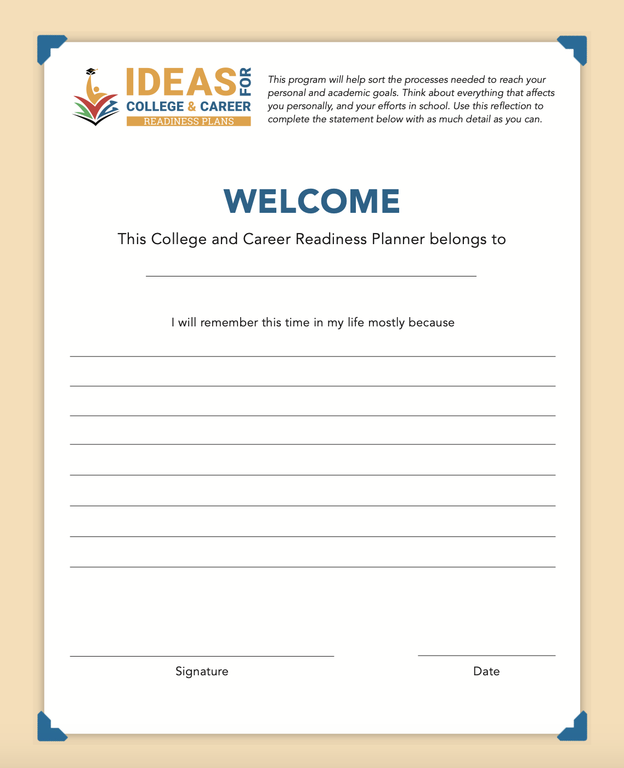
What seems to be most important to you right now?
Record your answer in
the Welcome page of
your Student Book.
Notes:
This “Welcome” page would be best presented to students as if it were a lens into their state of mind. In other words, the students should be encouraged to respond in a way that highlights the present -- where they are in life -- and what factors are occupying their thoughts at this time. The previous questions should help students to produce a more elaborate answer on this page. You may model by writing or describing your own description of where you are at in your life.
This welcome page is designed for all to reflect on welcoming stages in their academic and personal lives.
Extend the life of this activity as a future reflection piece – for them to revisit and reflect upon -- after they complete the workshops, or even after high school and beyond.

Slide 4

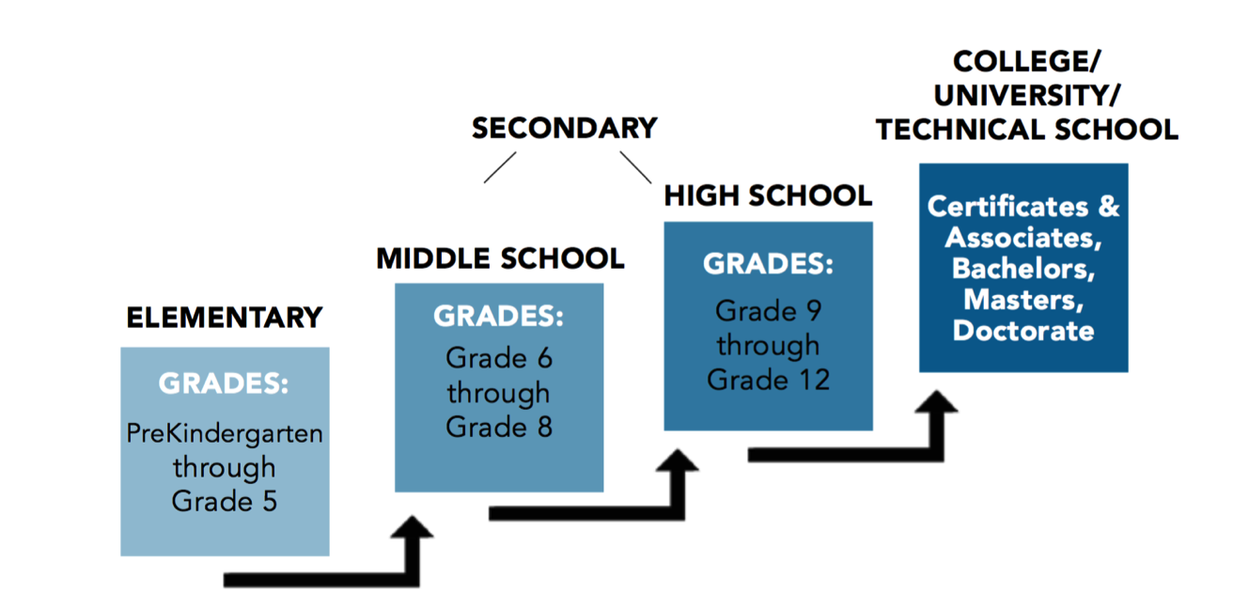
ACADEMIC TRACK – STUDENT BOOK PAGE 6
Where Are You In Your Schooling?
EVERY STEP COUNTS!
Notes:
The academic track on page 6 of the student book allows you to see where you are at and think about what you need to get ready for the next level in your school.
For middle school students, it is important to acknowledge that they are in Secondary School now, and that what they do in middle school counts for their future academic tracks.
For high school students, the diagram can demonstrate to them that they need to take actions now that will impact their career choices in the not too distant future.
Advise students that they should be getting ready for each next step in their level of schooling and for post graduation when they can go on to study their careers. Share with students that they can attend colleges, universities, or trade schools in order to pursue a career, that when employed, will help them support themselves and help them realize their life goals.
ling.

Slide 5

Knowing Where You Stand Will Help You Plan for
the Future
Review the diagram on Student Book page 6. Discuss with your friends where you are right now and what you plan to do to prepare for the next level.
Are there any academic experiences or study skills that you may transfer from one level to the next?
How soon can you start planning for college?
Turn to your shoulder partner and share your ideas. Ask your facilitator for help if you need assistance answering these questions.
.
.

Slide 6
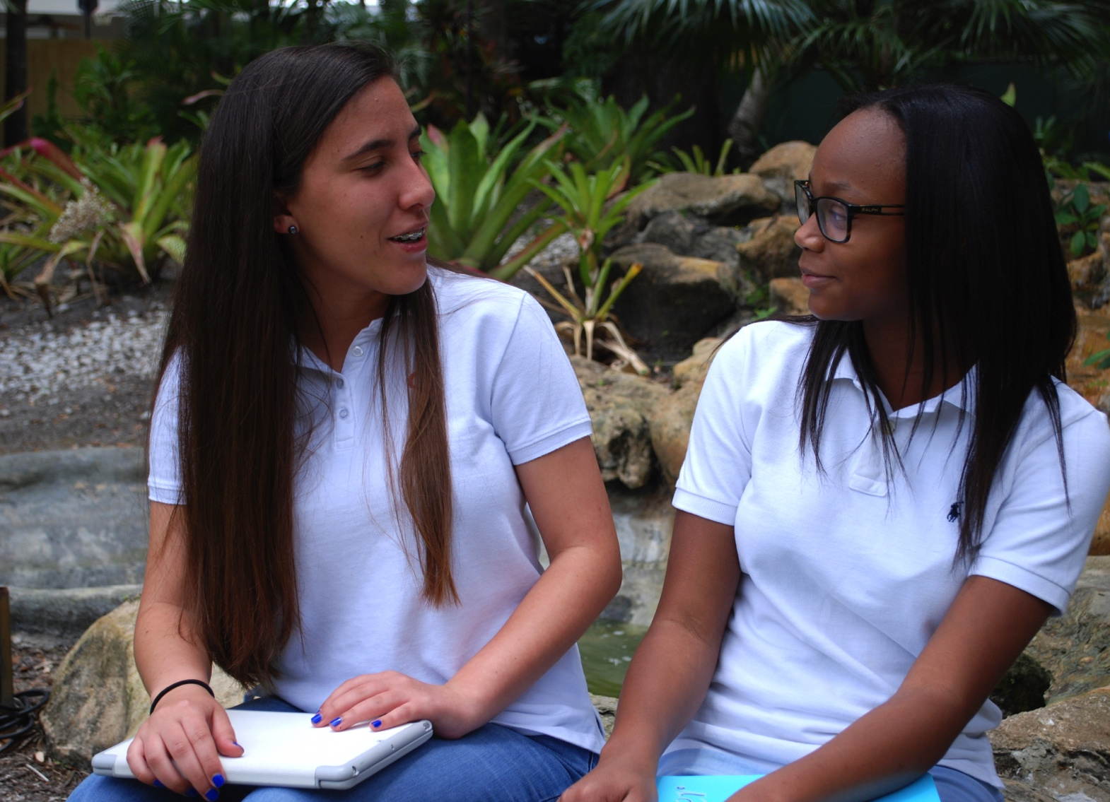
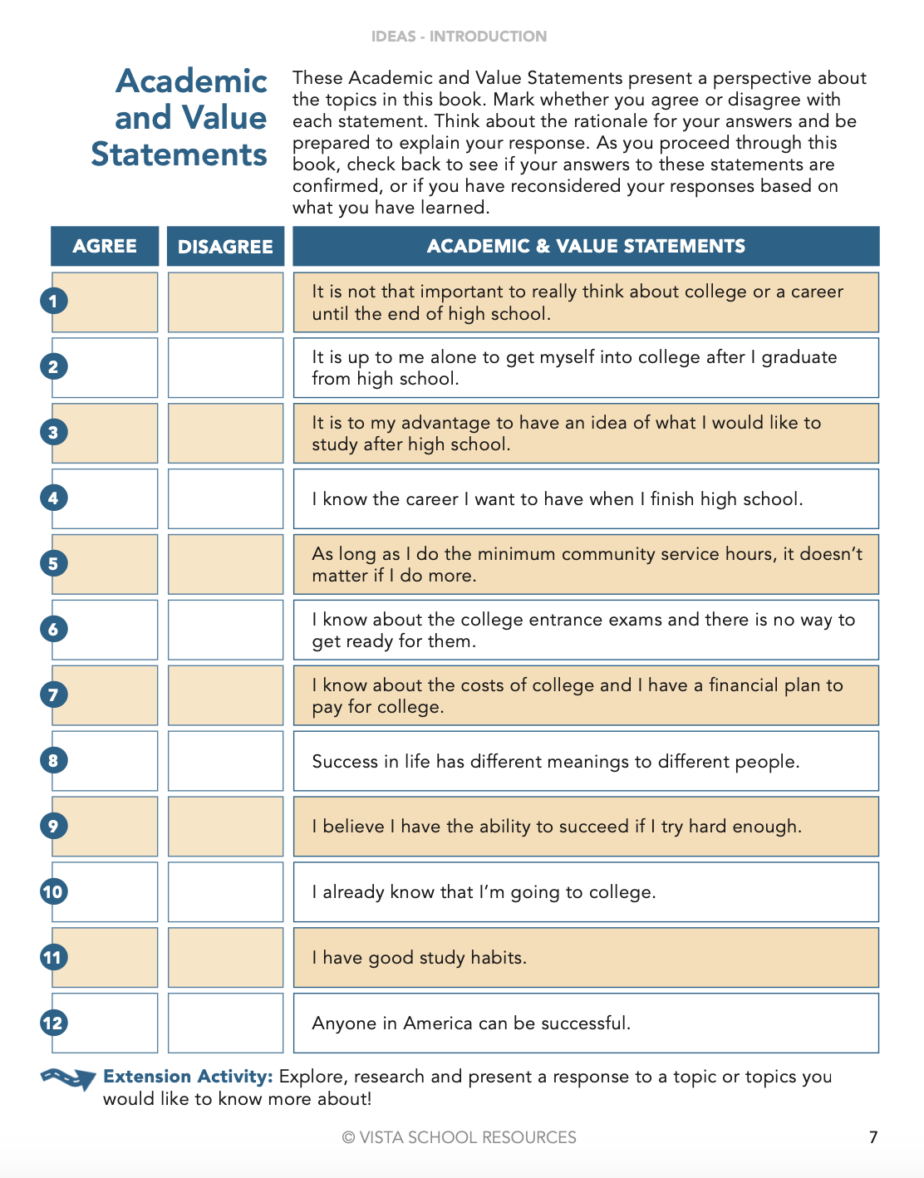
ACADEMIC AND VALUE STATEMENTS – PAGE 7
Agree or
Disagree?
Notes:
This is an opportunity to give students some exposure to the topics that will be addressed in this book and to listen to their peers’ opinions. An Anticipation Guide is designed to pique students’ interests about an upcoming reading and can serve to provide a personal response to topics that will later be addressed. Not only do they connect their own perspectives about the topic, but also they may become curious about it.
Read each statement together or ask them to respond individually, unless there are language barriers that a pair/share combination of pupils would bene t from. Ask students to check off whether they agree or disagree to each Academic and Value Statement. After giving the students a few minutes to answer, take a poll for each answer by asking them to raise their hands and invite volunteers to explain their answers. Accommodations: Read each one aloud and clarify the intention of each statement. Check any vocabulary needed to be explained for English language learners.

Slide 7
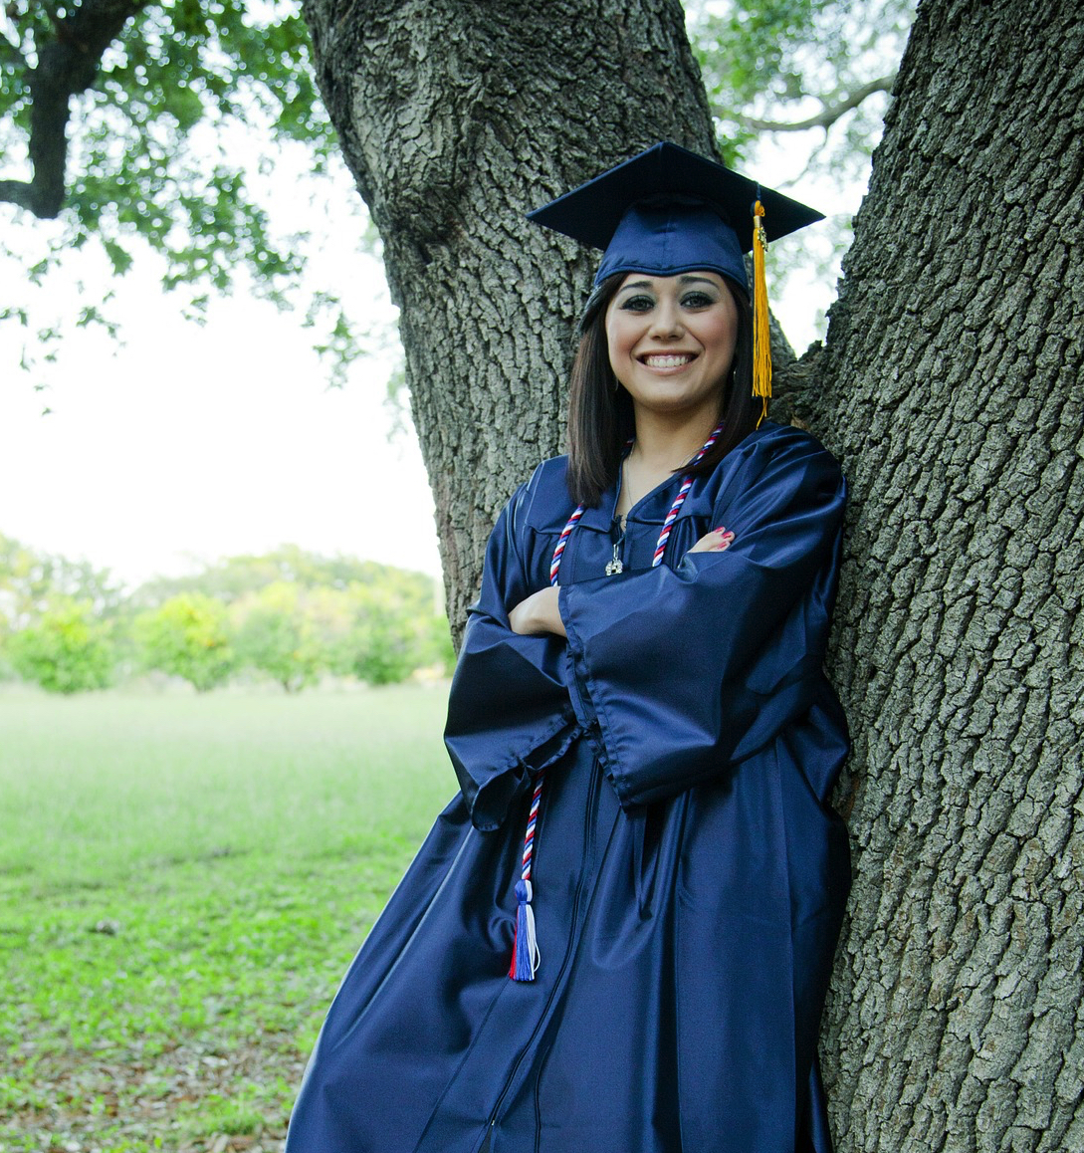
ACADEMIC AND VALUE STATEMENTS – PAGE 7
8. Success in life has different meanings to different people.
Say if you agree or disagree with this statement and explain why.
Use one of these sentence starters when you answer:
I agree with this statement.
For me being successful means _______________________________________________________________.
I disagree with this statement. Success in life means the same to everyone. You measure success by _______________________________________________________________.
.
.
Notes:
Sometimes its hard to begin to answer a question that could have different answers. Use this to model to show how students can answer these.
Ask students to think about their answer to this, share with a shoulder partner, and then share it together if this will scaffold their more independent responses to the rest of the questions.

Slide 8
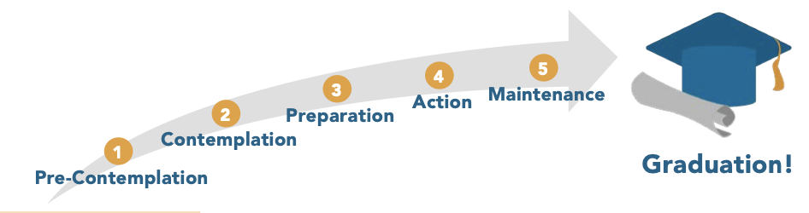
HOW ARE YOUR PLANS FOR GRADUATION PROGRESSING? – PAGE 8
College & Career Readiness Continuum
Notes:
THIS IS WHERE MANY STUDENTS WILL REALIZE ALL THAT LIES AHEAD AND HOW THEY WILL BE ABLE TO TAKE STEPS TO MAKE THEIR GOALS AND PLANS!
Page 3 in the student book displays a graphic of the continuum and a check list so that students may indicate by marking which statements apply to their thoughts and/or actions in their process and progress preparing for graduation and college. Share with students that the largest number (between 1 and 5) they can check off on the list of questions correlates directly with where they fall in the Stages of the College Preparedness Continuum.
To support English Language learners, read each stage and pause to clarify what each step or activity means.
Discussion of Continuum after self evaluation:
Segue with the idea that the time leading to graduation includes the plans for students’ lives after graduation. After the discussion, reference the inside back cover of the student book for the correlation of the continuum stages. Some of the tasks and suggestions on the CCRC will be specifIc to actions relating to college and others will be activities that should make their high school a better experience for them.

Slide 9
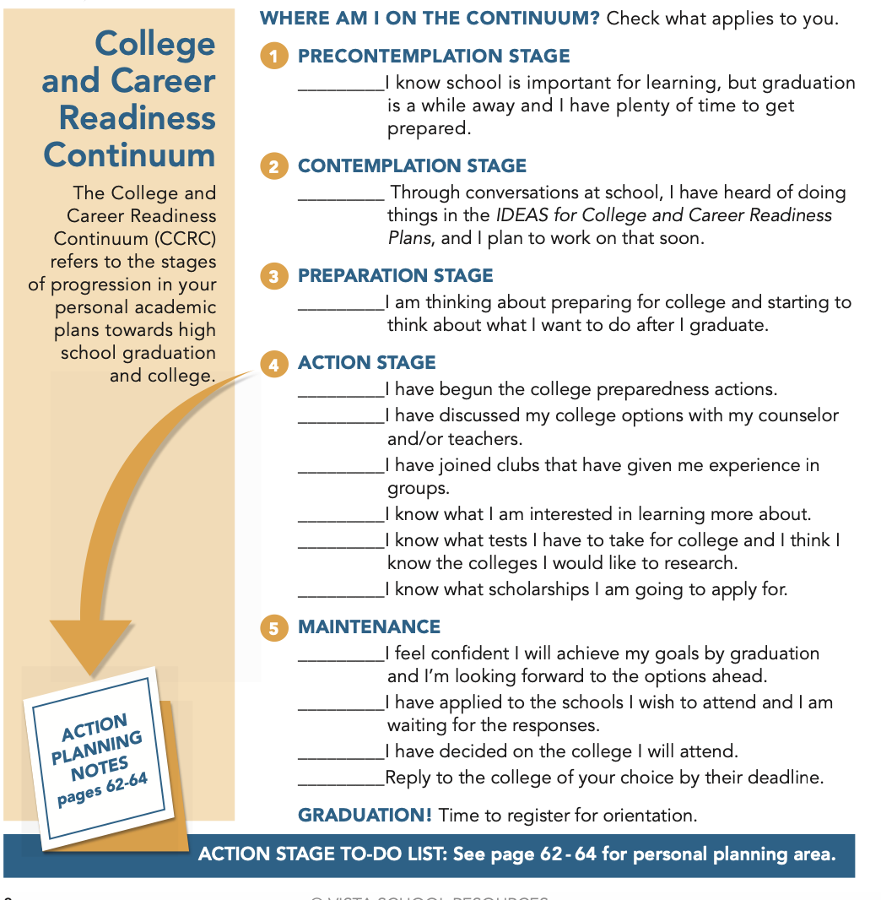
HOW ARE YOUR PLANS FOR GRADUATION PROGRESSING? – PAGE 8

Slide 10
WHERE ARE YOU WHEN IT COMES TO PREPARING
FOR COLLEGE?
.
Are you contemplating the idea of going to college?
Do you already have a plan?
Do you know where to find support to prepare for college?
Look at the College and Career Readiness Continuum in the Student Handbook page 8 and check all the statements that apply to you. Be ready to learn what you can do to be better prepared.
.
.

Slide 11
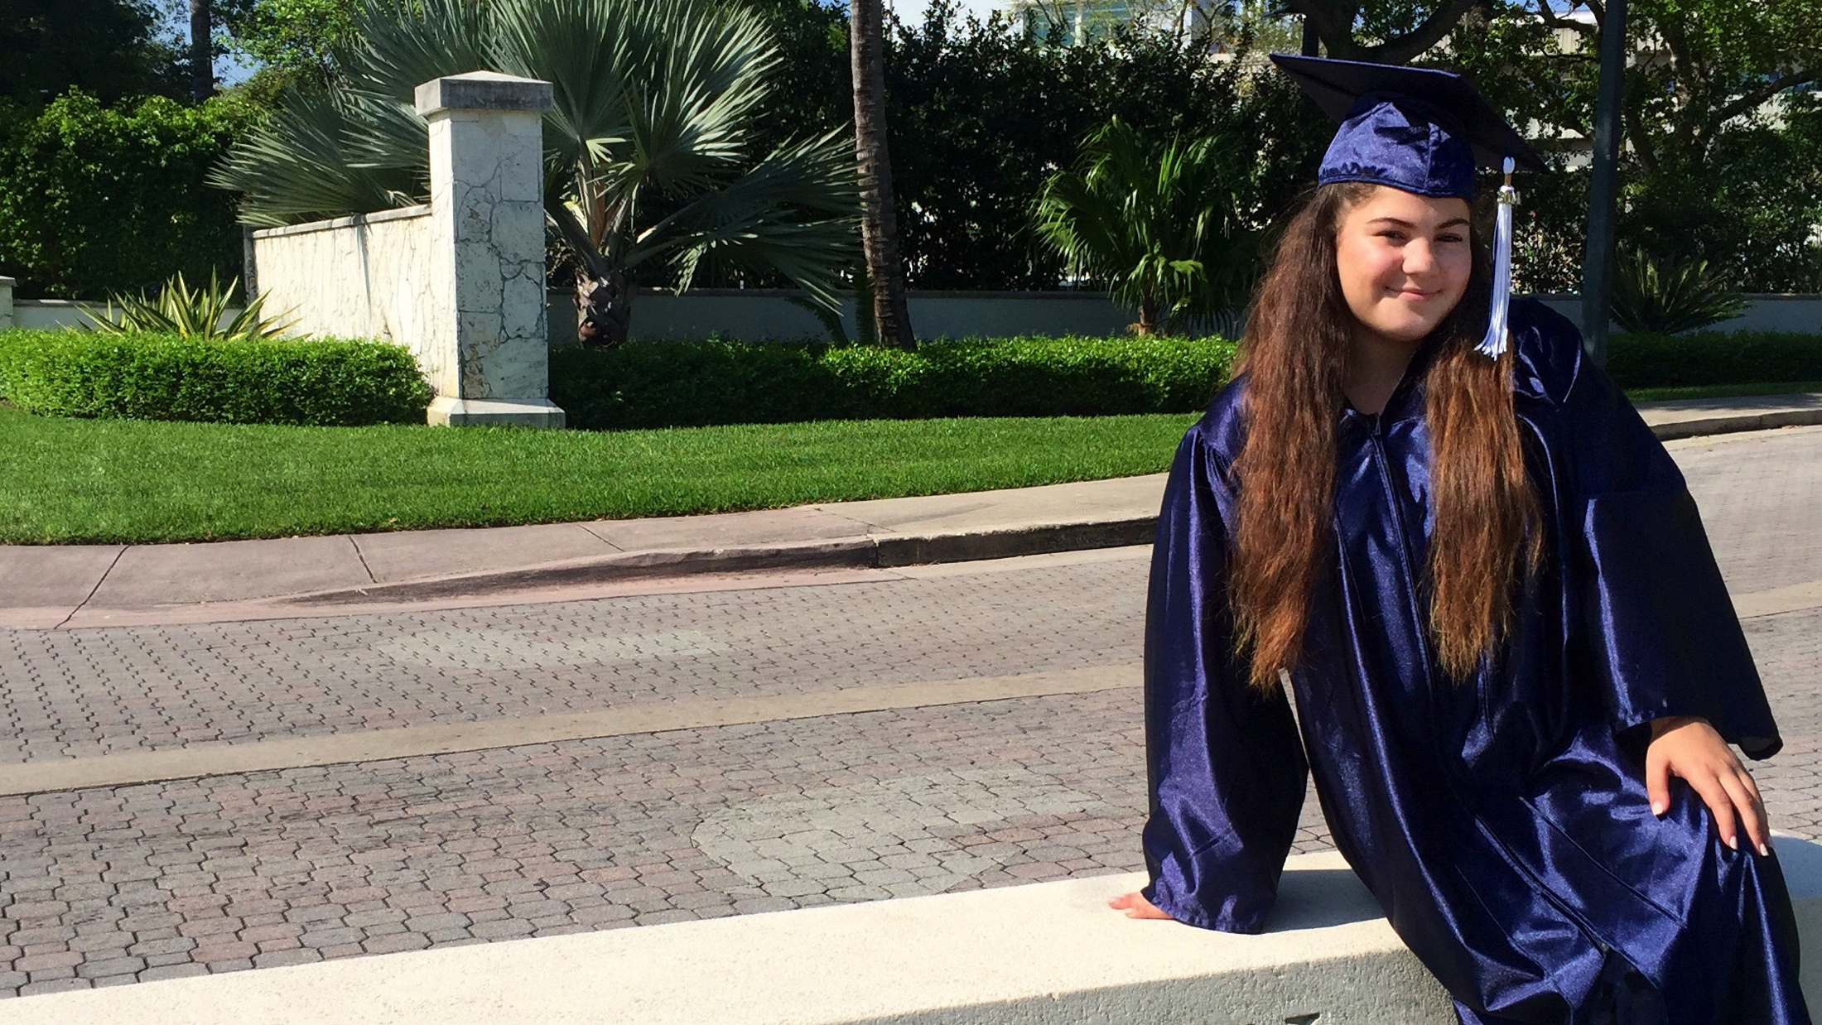
Where Do You Start?
Set Your Goals
Aim High
Look for Support
Have an Action Plan
Notes:
Nothing has to be done in one day, and assure students they should have time to begin to work on their action plans. This program will support the steps needed to be taken so that they can maximize their success!

Slide 12

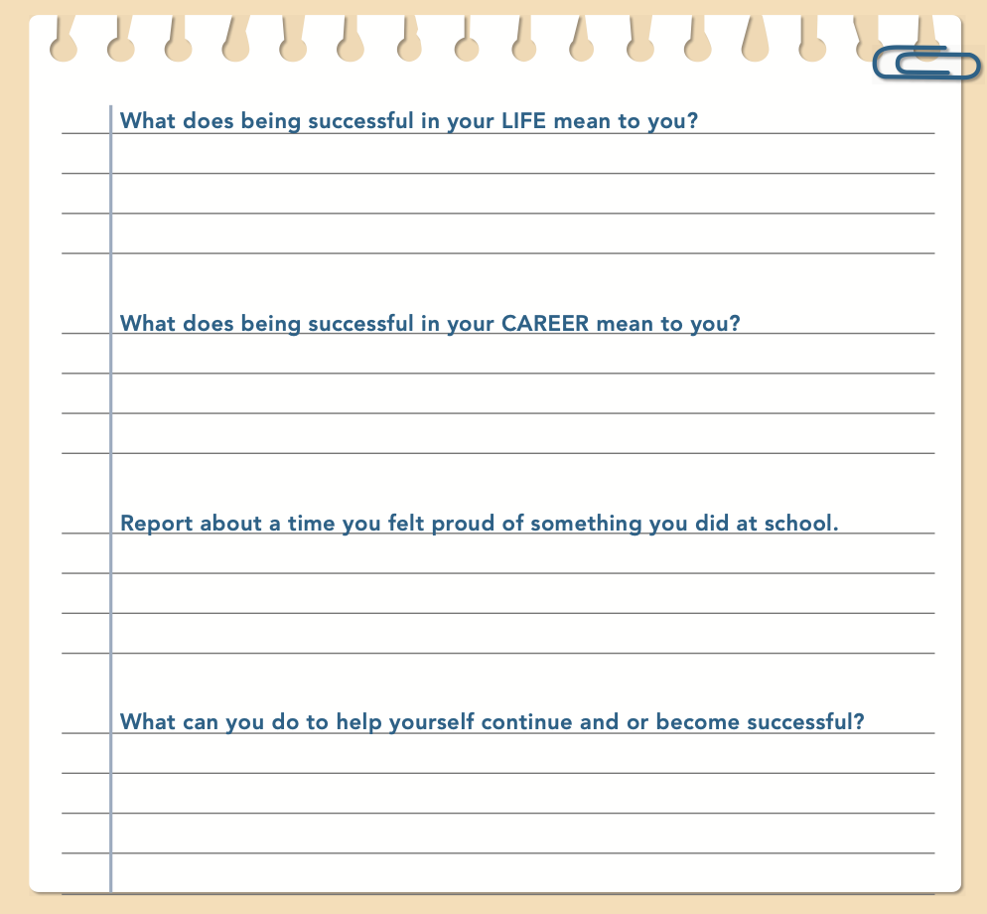
REFLECTION 1 – PAGE 9
What does being successful mean to you? Describe what you mean
and give examples when describing your reasons. Record you
reflection on Student Handbook page 9.
Writing
Notes:
After the previous discussion from the items on the college and career readiness continuum, read the Reflection prompt on page 9 of student IDEAS book. Ask students to spend 3-5 minutes thinking and writing their answers in about 30 words or less. Clarify that it is a two-part question.
Have them share with a peer in the class for about 30 seconds and then invite the group to volunteer their answers as a group discussion.
In a workshop setting, and if time allows, document and digest what student responses are, so they can notice how similar or different their peers thinking is from their own. On a chart, have them share out and document as bulleted points the “definition of success”. Separate out life and career success objectives. See facilitator guide for some examples of possible answers given by students: What does being successful mean to you - (in both your life and in your career?)

Slide 13
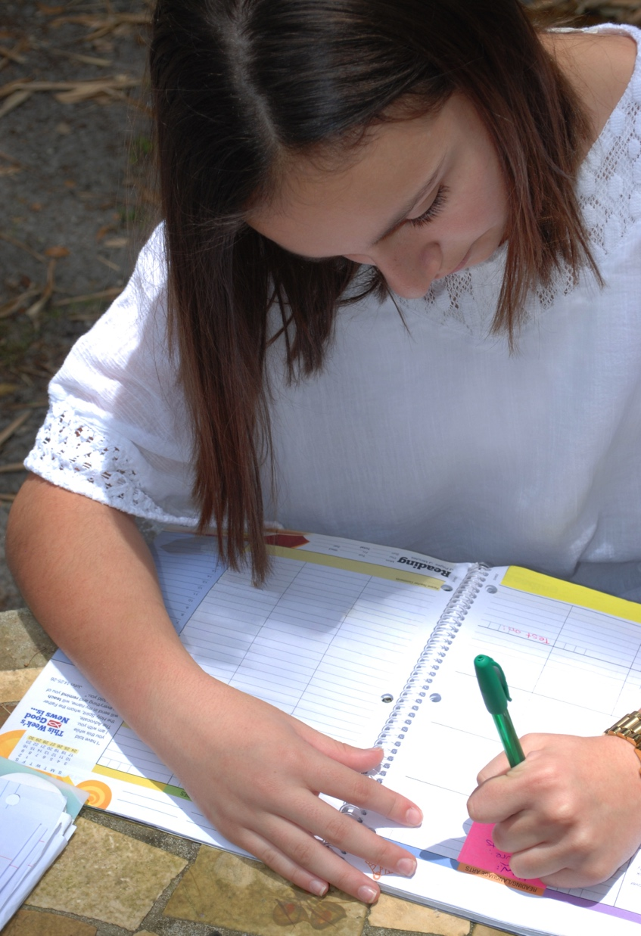

What does being successful mean to other people? These are some examples of what other students gave.
Do you agree, or disagree? Why?
LIFE: CAREER:

Slide 14


YOUR STUDENT BOOK FOR YOUR SUCCESS!
Notes:
Share with students that they have this tool, that they should value for not only what they are going to put into it, i.e., their thoughts, but also for what they are going to get out of it, in the way of information. Go back to the Table of Contents. Share that they are going to learn about ways to learn more about what they want, to make their goals, where they can get help, more information, and an orientation as to what will be expected on their way to graduation. They will also have a chance to learn about many possible choices they have in their futures. Explore with students what the icons on the cover could represent. Some of these will be new to them.
If there is time, have students look at the front cover and ask them to identify what the icons mean on the page. There may be more than one right answer- and this list of descriptions may not be exhaustive:
From left to right in rows they are: Row 1: Photography, Briefcase (for business or sales), Bank report, computers, judge. Row 2: Medical, chef, painter, carpenter/builder, police officer, mason, row 3: pilot/flight attendant, TV-Journalism/Camera/Director/Actor
Row 4: Global/Internet, Professional Golfer Row 5: Sports/Referee/Athlete/Coach, Film/Commercials/ App Developer, Graphs-Economist/Manager, Globe: Travel/Historian, Musician/Guitarist Row 6: Astronomer, JournalismEditor, Scientist, Writer, Dentist, Fashion Designer/Seamstress, Football/Sports, Row 7: Teacher/Principal, Veterinarian, Realtor, Ophthamologist/Eye Doctor, Contractor/Builder, Farmer/Agriculture/Husbandry, Row 8: Baseball/Softball, Appliance Repair/Engineer, Electrician, Social Worker/Negotiator/Mediator, Thespian/Actor, Clothing Designer/Seamstress

Slide 15
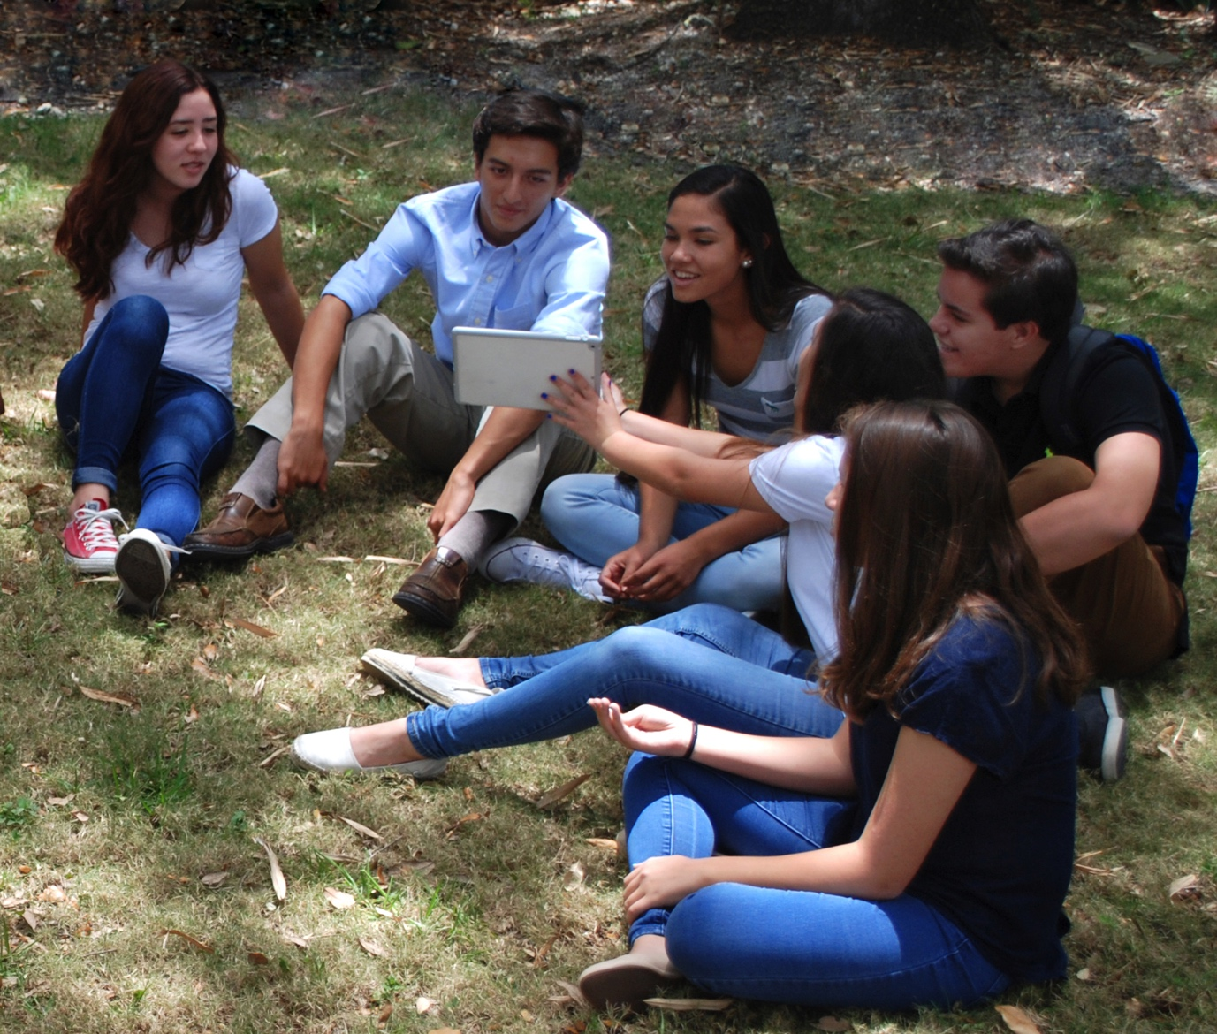

COLLECT YOUR THOUGHTS
Group Share
Today I learned…
.
1.___________________
___________________
2.___________________
___________________
3.___________________
___________________
.
.
Notes:
Ask students to take two minutes to write down three points they learned about today. These responses can be dated and written in the notes section of the student book which begins on page 62. Have several volunteers read their answers to the class. In a large group, have them partner share first, then ask teams to share with the class.

Slide 16
INSPIRATION
DETERMINATION
EXPECTATIONS
ACTION
STRATEGIES
A Path for Students’ Success
Notes:
Let students know:
(unless the Strategies session is conducted next)
The next session is called INSPIRATION and will provide support in planning your futures based on your interests and activities.

